Slide 1
SKILLTREE
Meet Ahmed and SkillTreeOS
Build your first
AI worker.
Give it your company context, a job and reusable skills.
Build the company OS it works inside.
Ahmed Alassafi
001 / 152
Notes:
Welcome the room. Today we build an AI worker: a running agent with a defined job, company context, reusable skills and an output the owner can inspect. We will open the company foundation, explain the parts, then put a content worker to work inside one department. The free packet contains the structure, prompts and worked examples. The cohort is the guided build of their own company.
Sources:
05-partners/SkillTreeOS/03-cohort/OFFER.md

Slide 2

SKILLTREE
Meet Ahmed and SkillTreeOS
Ahmed Alassafi
Founder of Altari and creator of SkillTree.
002 / 152
Notes:
Give the short version of your path into practical business AI. Connect your work to the recurring operational problems the audience wants to solve.
Sources:
https://altari.ai/

Slide 3
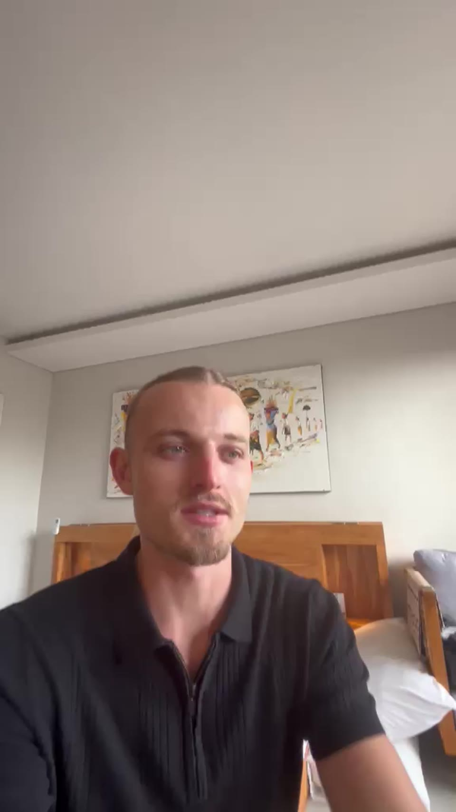
SKILLTREE
Meet Ahmed and SkillTreeOS
Hear it from Ash
Experiences with SkillTree and Altari, from the people using them.
1:05
Ash
Getting his AI workspace organized.
▶︎
Watch Ash’s story
Watch the videos at class.skilltreeos.ai/training#s003
003 / 152
Notes:
Play Ash’s 1:05 testimonial near the beginning. He describes getting his AI workspace organized. Jordan and Steve appear near the three-quarter point. Captions are auto-generated; verify against the audio. Video loads only on demand and pauses when changing slides.
Sources:
https://skilltreeos.ai/#testimonials

Slide 4
SKILLTREE
Meet Ahmed and SkillTreeOS
600+ businesses. The same question.
How do we make AI useful in the work we do every day?
004 / 152
Notes:
Ahmed spoke with 600+ businesses while at Relevance AI. Use this as experience listening to operators, not a claim that he implemented 600 systems. Explain one repeated business problem he personally recognizes, then show the published client examples.
Sources:
https://altari.ai/

Slide 5
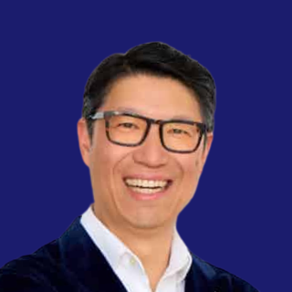

SKILLTREE
Meet Ahmed and SkillTreeOS
Company knowledge, in their words
★★★★★
★★★★★
“Twelve years of points knowledge lived in
my head. Now it lives in one company brain
the whole team can ask. It answers from our
own files, turns call notes into finished
follow-ups, and runs 24/7 without us
touching it.”
“Five years of institutional knowledge and
project history lived in files we had to
manually search. Now it’s a single system the
whole practice draws on. It answers from our
own work, holds our standards, and never
forgets a thing.”
Steve Hui
Brett Roake-Barefoot
Founder · The Flights Club
Principal · Ministry of Architecture + Interiors
005 / 152
Notes:
These six quotes are reproduced from the owner-supplied SkillTree/Altari client-review cards. Attribute each statement to the named client. They describe Altari client engagements, not guaranteed SkillTree cohort outcomes. The two former Flights Club response-time and Deel summary slides have been removed.
Sources:
https://skilltreeos.ai/#reviews
https://altari.ai/

Slide 6
SKILLTREE
Meet Ahmed and SkillTreeOS
AI adoption, in 2,500 dots
Each dot represents about 3.2 million people.
Notes:
Adapted from the owner-supplied graphic. It is an illustrative adoption snapshot circulating in February 2026, not a verified population survey or current subscription census. Preserve this qualification when presenting. The original labels 25M (0.03%) and 3.6M (0.004%) were arithmetically wrong: 25M/8.1B = 0.3086%; 3.6M/8.1B = 0.04444%. Counts and category definitions remain approximate and independently unverified. The primary chart circulating under Noah Epstein used coding-tool users rather than a confirmed Max-plan subscriber count. The supplied Max label is retained as an illustrative tier, not a product subscriber statistic. Dot allocation is a rounded illustration with paid/advanced tiers nested in the approximately 1.3B users; 2,099 + 392 + 8 + 1 = 2,500. Do not describe these estimates as evidence that 84% of people have never encountered any AI technology.
Sources:
Owner-supplied AI adoption graphic, 2026-09-10
https://x.com/NoahEpstein_/status/2025605338779496797
https://blog.ax0x.ai/the-last-mile-of-ai

Slide 7
SKILLTREE
Meet Ahmed and SkillTreeOS
The noise
→
“Here’s a cool prompt”
→
“5 AI tools you need to try”
→
Another wrapper with a monthly fee
→
A workflow that breaks the first time anything changes
007 / 152
Notes:
Recognize the noise the audience has already seen. Today they will build an AI worker with a defined job, company context and a way to inspect the result. A useful prompt can be part of that worker. The complete system also needs sources, instructions, tools and a handoff.
Sources:
Owner-supplied slide references, 2026-09-10

Slide 8
SKILLTREE
Meet Ahmed and SkillTreeOS
“The whole business
depends on me.”
A SkillTree waitlist response.
Drop 1 in the chat if this feels familiar.
008 / 152
Notes:
Verbatim anonymized problem statement from Tally, reference 336a328f4b in the local research. Do not call it a testimonial. Give people a beat to recognize the problem; then show what other respondents meant by wanting it all connected.
Sources:
docs/research/audience-and-training.md
docs/research/founderos-reference.md

Slide 9
SKILLTREE
Meet Ahmed and SkillTreeOS
“I want it all together.”
What people told us
What we are building
“The whole business depends on me.”
One place for company knowledge.
“Nothing is interconnected.”
Departments that can use it to do work.
009 / 152
Notes:
These are anonymized problem statements from completed SkillTree waitlist responses, not testimonials. The longer response was: “bringing it all together - i know how to build skills but i want it all together”. Ask: does this sound like your week? Pause for the chat.
Sources:
docs/research/audience-and-training.md
docs/research/founderos-reference.md

Slide 10
SKILLTREE
Meet Ahmed and SkillTreeOS
Get repeat work off your plate.
01
Win back time
Less chasing, finding files and rewriting.
02
Spend less on repetition
Reduce the preparation you have to do or outsource.
03
Make room to grow
More time for sales, clients and delivery.
010 / 152
Notes:
Translate each benefit into a familiar job. A follow-up waiting for you, a post waiting for approval, a weekly update assembled by hand. These are goals to measure on their own work, not promised savings. Next let them calculate a concrete example.
Sources:
Teaching packet: company second brain and Cedar Lane example

Slide 11
SKILLTREE
Meet Ahmed and SkillTreeOS
Four things change
01
02
03
04
Shared context
Tools you can
inspect
Your first AI worker
Encoding as a skill
Your worker reads your
company’s source
material, decisions and
constraints.
See which files it reads,
what it changes and
what it produces.
Give it a recurring job
with an output you can
judge.
Turn your knowledge
and ways of working
into reusable
instructions.
011 / 152
Notes:
Frame the session around building an AI employee. Use employee as a teaching analogy: an agent runs a defined job using the company context, a skill and the tools available in its harness. The owner sets the standard and reviews the work.
Sources:
Owner-supplied slide references, 2026-09-10

Slide 12
SKILLTREE
Meet Ahmed and SkillTreeOS
What would you do with four extra hours?
4 hours / week
Tasks each week
12
Minutes each today
30
16 hours / four weeks
$800 capacity value
Minutes with AI, including review
10
Value of an hour (USD)
50
Illustrative inputs. Human time includes review. Track setup,
upkeep and AI costs separately.
012 / 152
Notes:
Twelve follow-ups a week at thirty minutes each take six hours. At ten human minutes each, including review, the example releases four hours a week. Sixteen hours per four weeks at fifty dollars is eight hundred dollars of capacity value. These are illustrative inputs. Track upkeep and AI costs separately.
Sources:
Teaching packet: company second brain and Cedar Lane example

Slide 13
SKILLTREE
Meet Ahmed and SkillTreeOS
What is still waiting for you?
Leads, content, client work or admin?
Drop your biggest bottleneck in the chat.
013 / 152
Notes:
Read two responses. Around 70% of the deduplicated completed waitlist chose all departments. Acknowledge that: we are building the whole company foundation, then choosing the first piece of work to operate.
Sources:
Teaching packet: company second brain and Cedar Lane example

Slide 14
SKILLTREE
Meet Ahmed and SkillTreeOS
Your business, as an operating system.
Company brain
AI workforce
OS tools
What the business knows
Who does the work
Where you see the work
014 / 152
Shared knowledge. Clear jobs. Work you can open.
Notes:
OS means the working system around the company: its knowledge, people and agent roles, procedures, records and screens. It is not a replacement for macOS or Windows. Explain the outcome before the software names. The company is encoded broadly; one department is the first working result.
Sources:
05-partners/SkillTreeOS/03-cohort/OFFER.md

Slide 15
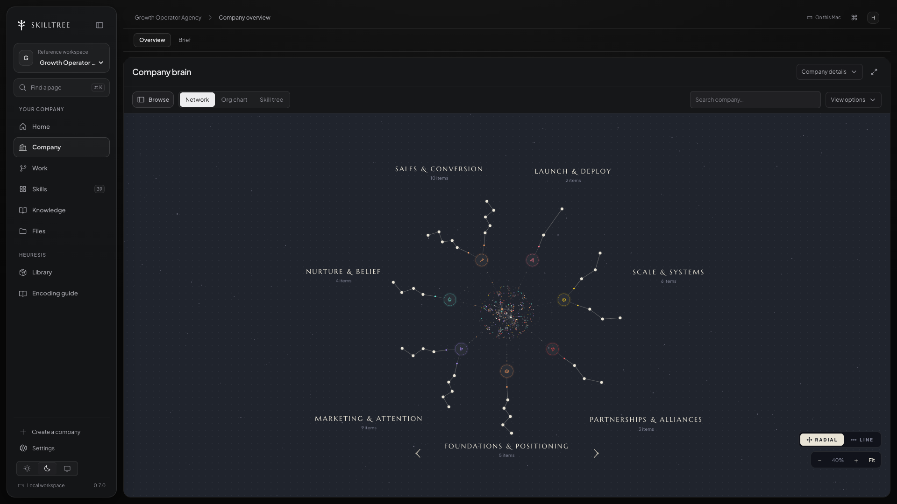
SKILLTREE
Meet Ahmed and SkillTreeOS
Let me open the company OS.
SkillTree development preview · Growth Operator Agency reference company
015 / 152
Notes:
Give a 45-second tour. Point to the company, one department and the files behind it. This is an actual captured SkillTree reference view, not proof every department is running. Do not explain the whole map yet. Promise to open these parts one at a time.
Sources:
docs/research/audience-and-training.md
docs/research/founderos-reference.md

Slide 16
SKILLTREE
Meet Ahmed and SkillTreeOS
Here is how we will build it.
01
See the OS
What it looks like and what it does.
02
Set up the workspace
The harness, editor and company folder.
03
Encode the company
Knowledge, agents, skills and departments.
04
Put it to work
A real task, OS tools and repeatable work.
05
Build yours with us
The six-class cohort and everything included.
016 / 152
Notes:
State the route: 70 minutes of teaching, followed by the 20-minute cohort offer window. Each new term answers a business question. We will use one prepared company throughout so nobody has to learn a new business every slide.
Sources:
05-partners/SkillTreeOS/03-cohort/OFFER.md
founderos/thefounderos-mgmt/cohort-1/07-webinar/2026-08-09-webinar-structure.md

Slide 17
SKILLTREE
Meet Ahmed and SkillTreeOS
Which one sounds like you?
1 · I run a business
2 · I am starting one
3 · I build systems for clients
017 / 152
Notes:
Ask them to type 1, 2 or 3. These are useful teaching routes, not measured waitlist demographics. Existing owner: bring your own sources. New business: define real offer and operating decisions. Client builder: learn the architecture, with licensing and client delivery terms checked separately. Keep a recurring job in mind.
Sources:
Teaching packet: company second brain and Cedar Lane example

Slide 18
SKILLTREE
Meet Ahmed and SkillTreeOS
This is for you if…
→
Your AI work is scattered across chats and tools
→
You have knowledge or recurring work you want an AI worker to use
→
You want to build for your own work before expanding to clients
→
You are willing to set it up, review the outputs and practice
018 / 152
Notes:
Include owners, operators and people building systems for clients. They need useful source material and willingness to review the work. Start with their own recurring responsibility so they can judge whether the worker actually helps.
Sources:
Owner-supplied slide references, 2026-09-10

Slide 19
SKILLTREE
Set up your AI workspace
Set up your
AI workspace.
Give the agent a place to read, work and save.
019 / 152
Notes:
Explain this idea through Cedar Lane Studio. Open the corresponding example when useful. Pause long enough for the audience to follow the relationship.
Sources:
founderos/thefounderos-mgmt/cohort-1/07-webinar/2026-08-09-webinar-structure.md

Slide 20
SKILLTREE
Set up your AI workspace
A useful answer. Then what?
Where is the current offer?
Where is the finished work?
How does tomorrow’s task find both?
020 / 152
Notes:
Use a concrete Monday-to-Tuesday example. You drafted a proposal yesterday. Today you need its status, the current price and the next action. This introduces persistent company work without making inaccurate claims that all chat products have no memory.
Sources:
Teaching packet: company second brain and Cedar Lane example

Slide 21
SKILLTREE
Set up your AI workspace
From conversations to company work.
One-off chat
Your company workspace
Ask a question. Get a useful answer.
Read the company sources and
instructions.
You often move the result into the
business yourself.
Save the result where the next job can
use it.
021 / 152
Notes:
Chat is useful for questions and drafting. For this recurring work we need explicit sources, durable instructions and saved outputs. Some chat products provide memory, projects and tools. The meaningful difference is the configured working process, not the shape of the text box.
Sources:
founderos/thefounderos-mgmt/cohort-1/07-webinar/2026-08-09-webinar-structure.md
https://code.claude.com/docs/en/how-claude-code-works

Slide 22
SKILLTREE
Set up your AI workspace
Why am I fixing the same thing again?
You corrected the offer in one conversation. What should
happen next?
Update the current offer source and any affected work. The next task
must read that source.
022 / 152
Notes:
Show the difference between a comment in a conversation and a changed source file. A remembered preference is not a substitute for checking a current business fact.
Sources:
Teaching packet: company second brain and Cedar Lane example

Slide 23
SKILLTREE
Set up your AI workspace
The model thinks. The harness acts.
The AI model
The agent harness
Works with the context it receives.
Gives it tools and manages the task.
Proposes an answer or next action.
Reads files, runs steps and saves work.
023 / 152
Notes:
A model produces responses. A coding-agent runtime can give a model access to permitted tools and files. What it can actually read or change depends on that runtime and the current task. You will use a working agent account in the cohort; that subscription is separate.
Sources:
https://code.claude.com/docs/en/how-claude-code-works

Slide 24
SKILLTREE
Set up your AI workspace
The harness is the driver’s seat.
The app that lets the AI work with your files and tools.
024 / 152
Notes:
An agent harness is the software around the model. It manages the session, context and permitted tool calls. Open the actual harness used for the demo. Point to a file read and a saved result. The next slide shows familiar examples; do not teach six installations.
Sources:
https://code.claude.com/docs/en/how-claude-code-works

Slide 25
SKILLTREE
Set up your AI workspace
Choose a harness. Keep your company.
Claude Code
Codex
Cursor
Anthropic
OpenAI
Editor + agent
Gemini CLI
GitHub Copilot
OpenCode
Google
GitHub
Open source
Pick one for the first build. Your company knowledge stays in readable files.
025 / 152
Notes:
These are examples of tools that can work on local code or files, not six required purchases. Use the configured harness for today’s walkthrough. The portable part is the readable company source; startup instructions, connectors and permissions still need checking when changing tools. Logos identify the products and do not imply endorsement.
Sources:
docs/research/audience-and-training.md
docs/research/founderos-reference.md

Slide 26
SKILLTREE
Set up your AI workspace
How an agent gets work done
Read
Act
Check
Continue
Gather the relevant
context
Use an allowed tool
Inspect the result
Use the result in the next
step
026 / 152
The relationship between the parts
Notes:
Trace a document task: read the offer, write a draft, open it, then correct it. Human review still determines whether the result is suitable.
Sources:
https://code.claude.com/docs/en/how-claude-code-works

Slide 27
SKILLTREE
Set up your AI workspace
What tools let the agent do
01
Read
Inspect selected files.
02
Write
Save or revise a draft.
03
Run
Execute a permitted command.
04
Connect
Use configured access to another system.
027 / 152
Notes:
A tool is a capability exposed to the runtime. Having a capability does not mean every action is authorized or every account is connected.
Sources:
https://code.claude.com/docs/en/how-claude-code-works

Slide 28
SKILLTREE
Set up your AI workspace
Superset is our workbench
An IDE is an integrated development environment: a place to work
with files.
We’ll use Superset to bring the agent, files and review together.
028 / 152
Notes:
Define IDE once in plain language. Superset is the workspace we are using for this training, with a built-in file editor. It brings agent sessions, files and review into one app. The model and agent harness still do their own jobs; Superset is not the model. Point to the three areas on the next slide.
Sources:
https://docs.superset.sh/editor
https://superset.sh/

Slide 29
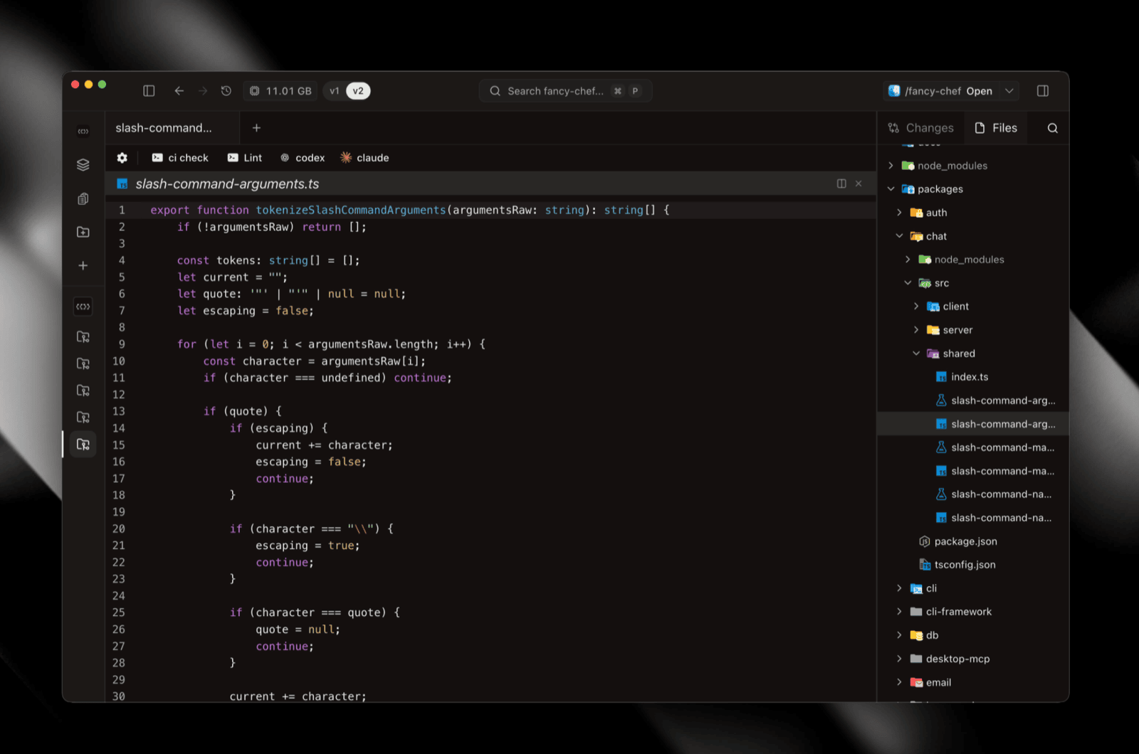
SKILLTREE
Set up your AI workspace
Inside Superset
Your files on the right. The open file in the centre. Agent tabs above.
029 / 152
Notes:
This is the official Superset file explorer screenshot. Point to Files on the right, the open file in the centre, then the Codex and Claude agent tabs above it. The screenshot uses the Superset team’s software project to orient the room. Our company folder will contain business knowledge and instructions; attendees do not need to understand the code shown here. In the live walkthrough, open the intended Cedar Lane company workspace.
Sources:
https://docs.superset.sh/editor

Slide 30
SKILLTREE
Set up your AI workspace
Three places to look in Superset
01
Files
Open the company knowledge and saved work.
02
The open file
Read the source or review the draft.
03
The agent tab
Describe the job and follow its progress.
030 / 152
Notes:
Refer back to the actual Superset screenshot. Files is on the right in this layout, the open file is in the centre, and agent tabs sit above it. Superset lets people arrange panes, so name each area rather than implying that every layout has the same positions.
Sources:
https://docs.superset.sh/editor

Slide 31
SKILLTREE
Set up your AI workspace
You can start in plain English.
“Read our offer and draft the next follow-up.”
The terminal runs commands. The agent can help carry out the steps. You
still need to understand what it is changing.
031 / 152
Notes:
In Superset, open the chosen agent tab and describe the task. Explain the terminal only as needed: it is one way to run software, including an agent harness. This is not a command memorization lesson.
Sources:
Teaching packet: company second brain and Cedar Lane example

Slide 32
SKILLTREE
Set up your AI workspace
Tell it what you need
Example instruction in the selected company folder
Read the current company offer and audience.
Use this week’s founder note.
Prepare a useful content brief.
Save a draft I can review.
032 / 152
Notes:
You describe the work in ordinary language. The workspace gives that request a concrete place to read from and write to.
Sources:
Teaching packet: company second brain and Cedar Lane example

Slide 33
SKILLTREE
Set up your AI workspace
The folder we open matters
01
Select
Open the intended company workspace in Superset.
02
Orient
Read the entry instructions and current state.
03
Choose
Name the source material for this task.
04
Inspect
Open the output and check what changed.
033 / 152
Notes:
Show the folder path. Opening a directory establishes a working location. It does not prove the model has read every file.
Sources:
Teaching packet: company second brain and Cedar Lane example

Slide 34
SKILLTREE
Set up your AI workspace
Did it read the file?
What turns file access into task context?
A clear job, selected sources and an interpretation the owner can review.
034 / 152
Notes:
The agent needs access to a file and a reason to read it. Inspect the sources it used. A large folder does not automatically become the active context for every task.
Sources:
05-partners/SkillTreeOS/03-cohort/cohort-1/07-webinar/SKILLTREE-METHOD-AND-DEMO.md

Slide 35
SKILLTREE
Set up your AI workspace
How your OS reaches your other tools.
Your email, calendar and CRM can stay where they are.
A connector gives the agent access to a specific tool. MCP is one
standard for those connections.
035 / 152
Notes:
Use an email follow-up as the example. Reading the last conversation needs email access; saving a draft needs a writing tool. Configure the accounts and permission for each job. Do not imply that connecting one service gives every agent every permission.
Sources:
https://code.claude.com/docs/en/how-claude-code-works
founderos/thefounderos-mgmt/cohort-1/07-webinar/2026-08-09-webinar-structure.md

Slide 36
SKILLTREE
Set up your AI workspace
Your existing services.
Connected where supported.
What you already use
Relevant company records
The worker’s job
•
Gmail
•
Messages
•
Slack
•
Contacts
●
Inbox triage
•
Stripe
•
Deals
●
Payment summary
→
→
•
Notion
•
Invoices
●
Sales follow-up
•
Google Drive
•
Documents
●
Knowledge upkeep
•
Your CRM
•
Events
A supported connector or export brings in the records. Each worker gets the access its job needs.
036 / 152
Notes:
Trace one example: a permitted CRM record supplies context for a sales follow-up draft. These are illustrative service and job categories, not claims that every service is already connected. The selected harness needs a supported connector, API or export and the owner’s account permissions. Records may stay in their original service or workspace. Workers read relevant, permitted context rather than inheriting every account. Bench displays company work and does not itself connect these accounts.
Sources:
Owner-supplied slide references, 2026-09-10
documentation/RUNTIME-COMPATIBILITY.md
documentation/APP-INTERFACE.md

Slide 37
SKILLTREE
Set up your AI workspace
One workspace. Four parts.
Superset
Harness
Company folder
Useful output
Your workspace and file
editor
How the agent works
What it reads and saves
What you review
037 / 152
The folder holds the company. The software works with it.
Notes:
Trace the relationship using one task. Superset is the working surface. The chosen harness runs the agent. The company folder holds its sources and saved work. The output is what the owner reviews. Superset and the harness are separate parts, even though the attendee can use them together in one app.
Sources:
https://docs.superset.sh/editor
https://superset.sh/

Slide 38
SKILLTREE
Set up your AI workspace
Make sense so far?
Drop 1 in the chat if you can find the workspace, the agent
and the files.
038 / 152
Notes:
Pause. If people are lost, reopen the Superset screenshot and point to Files, the open file and the agent tabs. Do not add new terminology.
Sources:
Teaching packet: company second brain and Cedar Lane example

Slide 39
SKILLTREE
Set up your AI workspace
Change the tool.
Keep the company knowledge.
Your offer, decisions and processes stay in files you can read.
039 / 152
Notes:
This is the ownership lesson from FounderOS. Changing software may require setup or adapters, but it need not erase the company knowledge. Now open the folder itself. Avoid “any harness automatically runs everything” or “zero ongoing costs”.
Sources:
docs/research/audience-and-training.md
docs/research/founderos-reference.md

Slide 40
SKILLTREE
Set up your AI workspace
Four reasons to build this way
01
02
03
04
Keep your files
Portable context
Readable
instructions
Build on the work
Your source material
and saved outputs stay
in your workspace.
Readable files can
move between
compatible tools and
models.
Open the source.
Inspect the worker’s
instructions and
correct them.
Reuse useful context
and improve the
instructions as you go.
040 / 152
Notes:
Explain why the company context, worker role and skill live in readable files. Portability applies to the files. A different harness may need its own tools, account connections and permissions. Corrections only persist when they are saved in the right source.
Sources:
Owner-supplied slide references, 2026-09-10
documentation/OWN-WORKSPACE.md
documentation/RUNTIME-COMPATIBILITY.md

Slide 41
SKILLTREE
Your company is a folder
Your company
is a folder.
Let’s open it and see what belongs where.
041 / 152
Notes:
Explain this idea through Cedar Lane Studio. Open the corresponding example when useful. Pause long enough for the audience to follow the relationship.
Sources:
Teaching packet: company second brain and Cedar Lane example

Slide 42
SKILLTREE
Your company is a folder
A folder and a file
Folder
File
Groups related material.
Contains the actual information.
Example: knowledge/
Example: knowledge/offer.md
042 / 152
Notes:
Explain this idea through Cedar Lane Studio. Open the corresponding example when useful. Pause long enough for the audience to follow the relationship.
Sources:
Teaching packet: company second brain and Cedar Lane example

Slide 43
SKILLTREE
Your company is a folder
Markdown is a readable text file
Example business note.md
# Current offer
A website clarity review for independent cafés.
## Unknown details
- Price
- Booking URL
043 / 152
Notes:
The .md extension means Markdown. The headings and simple list are still ordinary readable text. An editor can display them with formatting, and an agent can read the underlying text. You do not need to learn a programming language to understand this business note.
Sources:
05-partners/SkillTreeOS/03-cohort/cohort-1/07-webinar/SKILLTREE-METHOD-AND-DEMO.md

Slide 44
SKILLTREE
Your company is a folder
What does .md mean?
Is a Markdown document special AI code?
It is a plain-text document with simple formatting, such as headings and
lists.
044 / 152
Notes:
Open the same file in a text editor. A readable Markdown file is useful to the owner as well as the agent.
Sources:
Teaching packet: company second brain and Cedar Lane example

Slide 45
SKILLTREE
Your company is a folder
One folder. A company inside.
cedar-lane-studio/ · what is inside the company folder
01
Company setup
where to start
SYSTEM.md · AGENTS.md · company.yaml
02
Knowledge
your company second brain
company.md · offer.md · audience.md · voice.md
03
Departments
how the work is organized
marketing/ · sales/ · delivery/ · operations/ · finance/
cedar-lane-studio/
THE COMPANY HAS A HOME
04
The work
instructions, results and next steps
agents/ · skills/ · workflows/ · outputs/ · STATE.md
045 / 152
Notes:
Expand each folder. The icons indicate folders and documents. A name is useful because it tells both the owner and the agent what belongs there. Point from the blue folder to each panel. Use the file names or work examples to explain its role.
Sources:
Teaching packet: company second brain and Cedar Lane example

Slide 46
SKILLTREE
Your company is a folder
The company’s basic facts
company.yaml — fictional teaching example
name: Cedar Lane Studio
audience: independent cafés
offer: website clarity review
owner: studio founder
first_department: marketing
first_workflow: content brief and post draft
046 / 152
Notes:
YAML is another readable text format. The exact filename is less important than a clear home for the current facts. These are fictional teaching facts.
Sources:
Teaching packet: company second brain and Cedar Lane example

Slide 47
SKILLTREE
Your company is a folder
The sources behind the company
cedar-lane-studio/
knowledge/offer.md
knowledge/offer.md
Website clarity review. Check menu, hours and location. No
price or measured outcome supplied.
Current offer
knowledge/audience.md
Current audience
knowledge/voice.md
Judgment about wording
sources/founder-note.md
Current raw input
047 / 152
Notes:
Each source has a role. We do not load everything just because it exists. For this operation, the four selected sources tell us what the studio offers, who the work is for, how it should sound and what the current input is. Open each one briefly.
Sources:
05-partners/SkillTreeOS/03-cohort/cohort-1/07-webinar/SKILLTREE-METHOD-AND-DEMO.md

Slide 48
SKILLTREE
Your company is a folder
Give each file a job
knowledge/
company.md
company.md
Who we are, our current priorities and links to the
authoritative sources.
Overview
offer.md
Offer
audience.md
Audience
voice.md
Standards
decisions.md
Owner decisions
048 / 152
Notes:
Explain this idea through Cedar Lane Studio. Open the corresponding example when useful. Pause long enough for the audience to follow the relationship.
Sources:
Teaching packet: company second brain and Cedar Lane example

Slide 49
SKILLTREE
Your company is a folder
Which source is current?
Which source decides the studio’s current audience?
The owner-accepted audience file
A random old draft
The business in a reference example
Use the current owner-accepted source and resolve any material conflict.
049 / 152
Notes:
A source role tells us why we are reading it. A previous draft can be useful for structure, but it is not automatically current authority. If the sources conflict, the agent should expose that conflict rather than choose whichever phrase seems more convenient.
Sources:
05-partners/SkillTreeOS/03-cohort/cohort-1/07-webinar/SKILLTREE-METHOD-AND-DEMO.md

Slide 50
SKILLTREE
Your company is a folder
A company brain you can actually use.
A pile of information
A company second brain
Old prices beside current ones.
A current answer with a source.
Decisions buried in calls and
messages.
The decision, the reason and where it
applies.
050 / 152
Notes:
Explain this idea through Cedar Lane Studio. Open the corresponding example when useful. Pause long enough for the audience to follow the relationship.
Sources:
Teaching packet: company second brain and Cedar Lane example

Slide 51
SKILLTREE
Your company is a folder
Context points back to its sources
offer.md
What the studio offers
audience.md
Who it serves
context.md
voice.md
Relevant interpretation
How it writes
founder-note.md
This task’s input
051 / 152
Concept diagram
Notes:
The context makes the task easier to understand, but its statements remain traceable. When the owner changes a fact, we know which source owns it. The context is a useful index and interpretation. It should not erase the raw sources or pretend to update itself automatically.
Sources:
05-partners/SkillTreeOS/03-cohort/cohort-1/07-webinar/SKILLTREE-METHOD-AND-DEMO.md

Slide 52
SKILLTREE
Your company is a folder
A correction has a home
Owner correction
What changed?
Business fact
Reusable judgment
One task exception
Update the current
source
Update the skill
Record with the task
052 / 152
Concept diagram
Notes:
The first decision is about scope. Is this a fact about the business, a repeated way of deciding or an exception for one task? Save it where that scope belongs. That keeps reusable instructions useful and prevents a temporary exception from becoming a permanent rule.
Sources:
05-partners/SkillTreeOS/03-cohort/cohort-1/07-webinar/SKILLTREE-METHOD-AND-DEMO.md

Slide 53
SKILLTREE
Your company is a folder
Borrow the structure. Use your facts.
SkillTree library
Your workspace
Method and reference examples
Your facts and decisions
Reusable source and procedures
Your drafts and operating state
053 / 152
Notes:
A library contains examples, reusable method and tool source. Your own folder contains your business and its work. A reference company can teach a pattern, but its prices and customers do not become your facts. Keeping these roles separate is essential to using the library well.
Sources:
05-partners/SkillTreeOS/03-cohort/cohort-1/07-webinar/SKILLTREE-METHOD-AND-DEMO.md

Slide 54
SKILLTREE
Your company is a folder
Why keep versions?
What happens when an offer or rule changes?
Keep the history, identify the current version and update the work that
depends on it.
054 / 152
Notes:
Explain Git as a way to record and inspect changes. We need a visible history, not a lesson on every Git command.
Sources:
Teaching packet: company second brain and Cedar Lane example

Slide 55
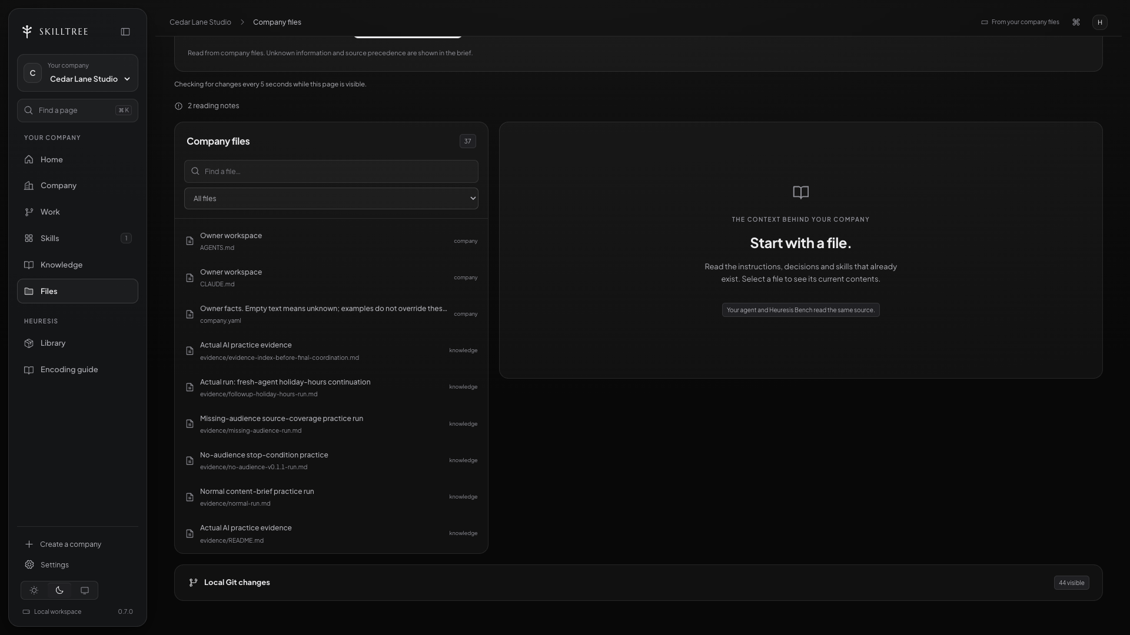
SKILLTREE
Your company is a folder
The actual company files in Bench
Local SkillTree preview · Company Files — fictional Cedar Lane example.
055 / 152
Notes:
This is the local preview’s Company Files view for the existing fictional dataset. It reads the connected folder at the Cedar Lane teaching workspace The source list includes instructions, knowledge and saved evidence. Open the offer, audience, voice and selected note for the live task. Visible file counts and local changes do not establish completed work.
Sources:
05-partners/SkillTreeOS/03-cohort/cohort-1/07-webinar/demo-workspace/knowledge/offer.md
05-partners/SkillTreeOS/03-cohort/cohort-1/07-webinar/demo-workspace/knowledge/audience.md
05-partners/SkillTreeOS/03-cohort/cohort-1/07-webinar/demo-workspace/knowledge/voice.md
05-partners/SkillTreeOS/03-cohort/cohort-1/07-webinar/demo-workspace/sources/founder-note.md
05-partners/SkillTreeOS/03-cohort/cohort-1/07-webinar/demo-workspace/knowledge/context.md
05-partners/SkillTreeOS/03-cohort/cohort-1/07-webinar/ahmed-webinar-slides-v2/research/SCREENSHOT-MANIFEST.json
/private/tmp/skilltree-webinar-cedar-lane-v2

Slide 56
SKILLTREE
Your company is a folder
Your first folder structure
Drop 1 if you can see where your offer, rules and outputs
would live.
056 / 152
Notes:
Ask for a missing folder or confusing file. Explain the role using their business rather than giving everyone a fixed giant directory tree.
Sources:
Teaching packet: company second brain and Cedar Lane example

Slide 57
SKILLTREE
The encoded company
Encode the
whole company.
What it knows. Who does what. How the work gets done.
057 / 152
Notes:
We have seen the folder. Now fill it with the real business: offer, customers, standards, responsibilities and decisions. Encoding makes those things available to the agent during work. We will make one department operational first; the rest gets a clear foundation.
Sources:
Teaching packet: company second brain and Cedar Lane example

Slide 58
SKILLTREE
The encoded company
Start with the business you already have.
What you already have
What goes into the OS
Your offer, proposals and customer
notes.
The current facts and where they came
from.
SOPs, good examples and decisions.
The way you want the work done.
058 / 152
Notes:
Explain this idea through Cedar Lane Studio. Open the corresponding example when useful. Pause long enough for the audience to follow the relationship.
Sources:
Teaching packet: company second brain and Cedar Lane example

Slide 59
SKILLTREE
The encoded company
From your material to a usable workspace
Your business material
What you build
Business knowledge
Company second brain
SOPs + playbooks
AI worker roles
Inbox threads
Reusable skills
CRM records
Encode
Your company OS
Department workflows
Spreadsheets
Meeting notes
Reviewable outputs
Brand assets
Saved next steps
Read the sources. Review the context. Give the worker a job and inspect its output.
059 / 152
Notes:
Show how existing material becomes a workspace that an AI worker can use. Sources become reviewed company knowledge, then role instructions, skills and workflows. Encoding saves the structure and judgment. Running the worker still requires an agent harness with the right tools and permissions. Use Cedar Lane’s founder note and content draft as the concrete thread.
Sources:
Owner-supplied slide references, 2026-09-10
examples/cedar-lane-studio/SYSTEM.md
examples/cedar-lane-studio/README.md

Slide 60
SKILLTREE
The encoded company
Five parts of an encoded company.
01
Context
What it knows about your business.
02
Agents
Who does each job.
03
Skills
How to do the job well.
04
Departments
Who owns what and how work moves.
05
Output
What was produced and what happens next.
060 / 152
Notes:
This is the company anatomy from the FounderOS explanation, adapted to SkillTree. Point back to the company folder. Use the same words throughout the rest of the class. A role file describes an agent; the harness must run it. A skill guides work; it is not itself an executing worker.
Sources:
Teaching packet: company second brain and Cedar Lane example

Slide 61
SKILLTREE
The encoded company
The encoded company, organized as files
cedar-lane-studio/
The company foundation
How the work gets done
SYSTEM.md
What this workspace owns
agents/
The content operator’s role
AGENTS.md
How the agent should work
skills/
How to create the content brief
company.yaml
Company and department map
workflows/
The steps and handoff
STATE.md
Saved progress and next action
departments/
Each department’s responsibility
What the worker knows
What the worker leaves behind
sources/
Original notes and evidence
outputs/
Briefs and draft posts
knowledge/
Current facts, audience and voice
evidence/
Run records and review results
Cedar Lane Studio is the fictional company included in your download.
061 / 152
Notes:
Use the actual included company example instead of the FounderOS snapshot. Every path shown is present in the Cedar Lane Studio download. Point to agents/content-operator.md, skills/content-brief/SKILL.md and workflows/content-production.md. The prepared company structure covers multiple departments; the saved practice evidence is for the content operation. Do not imply that all departments or connected services are running.
Sources:
Owner-supplied slide references, 2026-09-10
examples/cedar-lane-studio/README.md
examples/cedar-lane-studio/SYSTEM.md
examples/cedar-lane-studio/agents/content-operator.md

Slide 62
SKILLTREE
The encoded company
Start with the decisions that matter.
01
Current facts
What you sell, who it is for and today’s terms.
02
Your judgment
What you choose, why and what you reject.
03
Good examples
Show the standard you want the work to meet.
04
Supporting material
Link the relevant notes, calls and documents.
062 / 152
Notes:
Borrow FounderOS’s helpful idea of an order for context. Do not dump an entire drive in first. Start with the decisions the next job depends on, then add sources that help explain them. The source owner resolves conflicts; latest date alone does not make a fact authoritative.
Sources:
docs/research/audience-and-training.md
docs/research/founderos-reference.md

Slide 63
SKILLTREE
The encoded company
Tell it how your business works.
Teaching prompt — company discovery
Read the business sources I selected.
Ask about gaps that change how the company operates.
Cover the offer, audience, delivery and standards.
Propose a company overview with links to the sources.
Read it back to me before treating it as current.
063 / 152
Notes:
Describe the onboarding interview. You can answer in text or use a transcribed voice note. The value comes from reviewing what the system understood, not from filling every possible field.
Sources:
Teaching packet: company second brain and Cedar Lane example

Slide 64
SKILLTREE
The encoded company
A small source packet
sources/
website-notes.md
website-notes.md
What the business says it sells.
Public offer
proposal-example.md
Scope and language
founder-note.md
Operating judgment
call-notes.md
Customer context
064 / 152
Notes:
Explain this idea through Cedar Lane Studio. Open the corresponding example when useful. Pause long enough for the audience to follow the relationship.
Sources:
Teaching packet: company second brain and Cedar Lane example

Slide 65
SKILLTREE
The encoded company
What should the agent ask you?
Which fact would change the work if it misunderstood your
company?
065 / 152
Notes:
Offer scope, reader, delivery process and quality standards are useful answers. Ask a question only when it changes the interpretation or next action.
Sources:
Teaching packet: company second brain and Cedar Lane example

Slide 66
SKILLTREE
The encoded company
Turn your sources into company knowledge.
Prompt 1: orient and draft
Read the selected offer, audience, voice and founder note.
We are encoding one content-brief operation.
Draft the relevant context and link the sources.
Name material conflicts and missing facts.
Preserve existing owner content.
Show what would change the brief.
066 / 152
Notes:
This prompt asks for a reviewable interpretation. It avoids a company-wide interview before we know the actual dependency. Some tasks need more context, and we can collect it when it matters. For this small brief, we can begin by reading the four selected files.
Sources:
05-partners/SkillTreeOS/03-cohort/cohort-1/07-webinar/SKILLTREE-METHOD-AND-DEMO.md

Slide 67
SKILLTREE
The encoded company
Did it understand your company?
knowledge/context.md — excerpt
Purpose: help independent café owners spot website gaps.
Offer: website clarity review.
Sources: offer.md, audience.md, voice.md, founder-note.md.
Output: one brief for owner review.
Unknown: price, booking URL and measured outcomes.
067 / 152
Notes:
Read the interpretation back to Ahmed. Ask whether the audience, job, invitation and limits are right. This excerpt is adapted from the prepared fictional context. During the live build, open the actual newly produced context and respond to its real strengths and weaknesses.
Sources:
05-partners/SkillTreeOS/03-cohort/cohort-1/07-webinar/demo-workspace/knowledge/context.md

Slide 68
SKILLTREE
The encoded company
Does the answer match your business?
The context says “premium restaurants.” What should the owner do?
Accept it because it sounds polished
Correct the audience and reconcile the context
Add more decorative language
Save the current audience in its authoritative source, then fix affected derived work.
068 / 152
Notes:
A fluent description can still be wrong. The correction needs to survive in the source that owns the audience. We also reconcile the context and any affected output. Simply correcting the answer in chat leaves the next session vulnerable to the same misunderstanding.
Sources:
05-partners/SkillTreeOS/03-cohort/cohort-1/07-webinar/SKILLTREE-METHOD-AND-DEMO.md

Slide 69
SKILLTREE
The encoded company
Teach it the correction. Keep it.
Prompt 2: save the owner decision
Our current audience is independent cafés.
Preserve the original raw note.
Update the authoritative audience source if needed.
Reconcile the context and affected draft.
Show what changed and what still needs review.
069 / 152
Notes:
This instruction tells the agent how to handle history and dependencies. It does not authorize changes to unrelated files. The phrase 'if needed' matters: the current source may already be correct. We then update only the interpretation or draft that actually needs reconciliation.
Sources:
05-partners/SkillTreeOS/03-cohort/cohort-1/07-webinar/SKILLTREE-METHOD-AND-DEMO.md

Slide 70
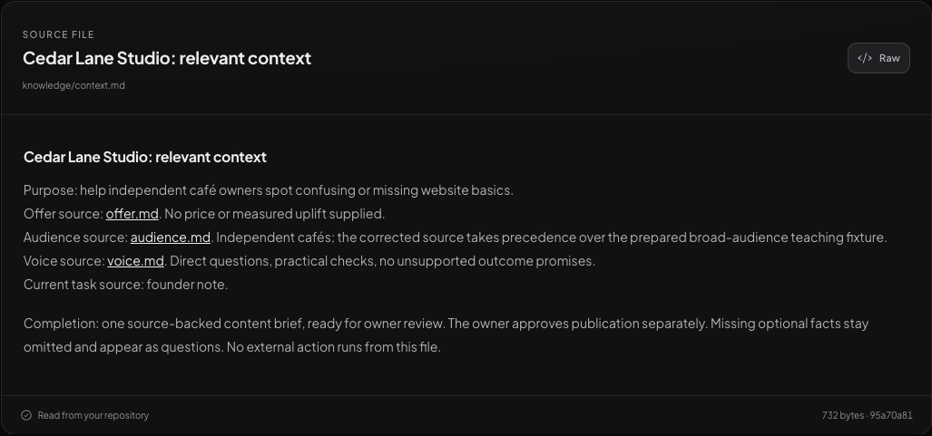
SKILLTREE
The encoded company
The company context in Bench
Local SkillTree preview · source-reader detail of knowledge/context.md.
070 / 152
Notes:
This is the actual context file from the existing fictional dataset, displayed in the local source reader. It summarizes the relevant facts and links to the offer, audience, voice and founder note. The completion line keeps the brief ready for owner review. During the live build, open the current file and show any genuine refinement separately.
Sources:
05-partners/SkillTreeOS/03-cohort/cohort-1/07-webinar/demo-workspace/knowledge/context.md
05-partners/SkillTreeOS/03-cohort/cohort-1/07-webinar/ahmed-webinar-slides-v2/research/SCREENSHOT-MANIFEST.json
/private/tmp/skilltree-webinar-cedar-lane-v2/knowledge/context.md

Slide 71
SKILLTREE
The encoded company
One company. Connected departments.
Local SkillTree development preview · Growth Operator Agency historical reference
071 / 152
Notes:
Show this historical reference company map. It illustrates how functions relate. Then return to Cedar Lane’s current company files. A diagram of the whole company does not establish that every department has run.
Sources:
Heuresis reference library/documentation/SKILLTREE-DESIGN.md
05-partners/SkillTreeOS/03-cohort/cohort-1/07-webinar/ahmed-webinar-slides-v2/research/SCREENSHOT-MANIFEST.json

Slide 72
SKILLTREE
The encoded company
One company. Connected AI workers.
You direct the work.
You set the priorities and approvals
Marketing
Sales
your-company/
Delivery
Shared context + coordination
Operations
Finance
Start with one worker. Add roles and handoffs around the company’s real responsibilities.
072 / 152
Notes:
The company folder supplies the shared context and routing instructions. In a configured runtime, an orchestrating agent can coordinate the workers. The owner sets priorities and allowed actions. This is an example structure, not a required department count or evidence of autonomous execution. Cedar Lane includes these five department folders; only the content operation has saved practice evidence.
Sources:
Owner-supplied slide references, 2026-09-10
examples/cedar-lane-studio/company.yaml
examples/cedar-lane-studio/SYSTEM.md

Slide 73
SKILLTREE
The encoded company
Every department reads the same brain.
departments/ · one company brain, connected departments
01
Marketing
create demand
Founder notes → content brief → draft post
02
Sales
turn interest into customers
Call notes → follow-up → proposal
03
Delivery
do the work you sold
Accepted scope → client work → quality check
departments/
SHARED FACTS. CLEAR JOBS.
04
Operations + finance
keep the business running
Handoffs · schedules · invoices · payment records
073 / 152
Notes:
Explain this idea through Cedar Lane Studio. Open the corresponding example when useful. Pause long enough for the audience to follow the relationship. Point from the blue folder to each panel. Use the file names or work examples to explain its role.
Sources:
Teaching packet: company second brain and Cedar Lane example

Slide 74
SKILLTREE
The encoded company
Marketing reads the company brain
departments/marketing/
README.md
README.md
Turn the company’s knowledge into useful material for
independent cafés.
Responsibility
content-workflow.md
Sequence
review-standard.md
Quality
074 / 152
Notes:
Explain this idea through Cedar Lane Studio. Open the corresponding example when useful. Pause long enough for the audience to follow the relationship.
Sources:
Teaching packet: company second brain and Cedar Lane example

Slide 75
SKILLTREE
The encoded company
Sales uses the same current offer
departments/sales/
README.md
README.md
Prepare accurate next steps from customer conversations.
Responsibility
follow-up.md
Workflow
limits.md
Judgment
075 / 152
Notes:
Explain this idea through Cedar Lane Studio. Open the corresponding example when useful. Pause long enough for the audience to follow the relationship.
Sources:
Teaching packet: company second brain and Cedar Lane example

Slide 76
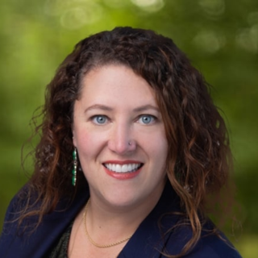

SKILLTREE
The encoded company
Sales, in their words
★★★★★
★★★★★
“As an executive recruiting firm, we needed
outbound that felt strategic and
relationship-driven. Altari built us an AI-driven
outreach engine, adaptive and
repeatable. In the pilot, we built real pipeline
and closed a new client.”
“Lead research & qualification used to
manually take hours each day, and now it’s
done in the background. Altari has
completely changed how we do this.
Research quality is better too, less errors.”
Sarah Telgarsky
Nick Roose
Principal & Sales Lead · Impact Partners
Sales Manager · Deel
076 / 152
Notes:
These six quotes are reproduced from the owner-supplied SkillTree/Altari client-review cards. Attribute each statement to the named client. They describe Altari client engagements, not guaranteed SkillTree cohort outcomes. The two former Flights Club response-time and Deel summary slides have been removed.
Sources:
https://skilltreeos.ai/#reviews
https://altari.ai/

Slide 77
SKILLTREE
The encoded company
Delivery and operations have a place too
departments/
delivery/README.md
delivery/README.md
Website clarity review: inspect menu, hours and location.
Record observations for owner review.
Delivery
operations/README.md
Operations
finance/README.md
Finance
077 / 152
Notes:
Encoding these responsibilities does not require pretending those departments are automated. We are making their purpose and required context explicit. The first operating department follows.
Sources:
Teaching packet: company second brain and Cedar Lane example

Slide 78
SKILLTREE
The encoded company
The OS should ask, not make it up.
The company has no approved price in its sources. What
should the brain say?
Price is not supplied. Ask the owner when a priced proposal requires it.
078 / 152
Notes:
A company second brain should distinguish knowledge from a gap. We can complete a useful educational draft without inventing a commercial term.
Sources:
Teaching packet: company second brain and Cedar Lane example

Slide 79
SKILLTREE
The encoded company
Change the offer once. Check the work.
Marketing
Update the invitation
Current offer
Sales
The owner changes the
scope
Update proposal language
Delivery
Update what the checklist
covers
079 / 152
The relationship between the parts
Notes:
Explain this idea through Cedar Lane Studio. Open the corresponding example when useful. Pause long enough for the audience to follow the relationship.
Sources:
Teaching packet: company second brain and Cedar Lane example

Slide 80
SKILLTREE
The encoded company
Open any part of your company
cedar-lane-studio/
knowledge/
knowledge/
Current facts, judgments and links to the original sources.
What the company knows
departments/
How the company works
agents/
Who performs the work
skills/
How a job is done
workflows/
How jobs connect
STATE.md
Where we continue
080 / 152
Notes:
Explain this idea through Cedar Lane Studio. Open the corresponding example when useful. Pause long enough for the audience to follow the relationship.
Sources:
Teaching packet: company second brain and Cedar Lane example

Slide 81
SKILLTREE
The encoded company
Can you see the company second brain?
Drop 1 if you can see how the same company knowledge
supports different departments.
081 / 152
Notes:
This is the central build. We encode the whole company foundation, then put one department to work on it. Ask someone to name a fact two departments would share.
Sources:
Teaching packet: company second brain and Cedar Lane example

Slide 82
SKILLTREE
The encoded company
The Encoded Company
01
Context
Reviewed background and current decisions
02
Agents
Responsibilities, inputs and allowed actions
03
Skills
Reusable instructions you can test and improve
04
Structure
Where the work and rules belong
05
Output
Saved and dated, ready to inspect
082 / 152
Notes:
Recap the company foundation before opening the worker’s role. Ask attendees to describe the five parts in plain English. The next section explains how the AI worker uses that context, follows a skill and leaves reviewable work.
Sources:
Owner-supplied slide references, 2026-09-10
examples/cedar-lane-studio/SYSTEM.md
examples/cedar-lane-studio/agents/content-operator.md

Slide 83
SKILLTREE
Your AI workforce
Your AI workforce.
Agents do the work. Skills teach them how.
083 / 152
Notes:
Explain this idea through Cedar Lane Studio. Open the corresponding example when useful. Pause long enough for the audience to follow the relationship.
Sources:
Teaching packet: company second brain and Cedar Lane example

Slide 84
SKILLTREE
Your AI workforce
Agents: who does the work.
Give each agent a clear job, the right context and the tools it needs.
084 / 152
Notes:
Think about giving a new hire a job description. Our content operator prepares content; a sales operator would prepare sales work. The role is written in a file. A running agent uses that role in the harness. Do not turn a file count into a claim that a whole workforce is active.
Sources:
Teaching packet: company second brain and Cedar Lane example

Slide 85
SKILLTREE
Your AI workforce
Skills: how the job gets done.
Your process, examples and standards, written where the agent can
use them.
085 / 152
Notes:
A good skill contains the steps and your judgment: how to choose an angle, which claim needs evidence, what a useful draft looks like. Writing it once gives future work a starting point. It still needs testing, review and updates.
Sources:
Teaching packet: company second brain and Cedar Lane example

Slide 86
SKILLTREE
Your AI workforce
The worker and the playbook.
company/ · how agents and skills work together
01
Agent
who does the work
content-operator.md — your content worker’s instructions
02
Skill
how to do a particular job
content-brief/SKILL.md — steps and quality rules
03
Workflow
the order of the work
Read sources → make brief → draft → review
company/
EACH PART HAS A JOB
04
Output
what you can open and use
outputs/ — the saved brief, draft and review
086 / 152
Notes:
Explain this idea through Cedar Lane Studio. Open the corresponding example when useful. Pause long enough for the audience to follow the relationship. Point from the blue folder to each panel. Use the file names or work examples to explain its role.
Sources:
Teaching packet: company second brain and Cedar Lane example

Slide 87
SKILLTREE
Your AI workforce
Role instructions and a running agent
Defined role
Observed run
Responsibility and scope are written
down.
The runtime uses context and tools.
A result and review record exist.
087 / 152
Notes:
This is how we avoid mistaking a folder of roles for an operational department. Show the task and resulting artifact when demonstrating a run.
Sources:
Teaching packet: company second brain and Cedar Lane example

Slide 88
SKILLTREE
Your AI workforce
One worker. Several useful skills.
Content operator
Brief skill
Draft skill
Review skill
Performs the current task
Select a useful angle
Write for the reader
Check against the
standards
088 / 152
The relationship between the parts
Notes:
Explain this idea through Cedar Lane Studio. Open the corresponding example when useful. Pause long enough for the audience to follow the relationship.
Sources:
Teaching packet: company second brain and Cedar Lane example

Slide 89
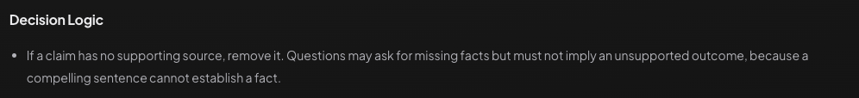
SKILLTREE
Your AI workforce
How a skill guides the agent
Actual source excerpt · Decision Logic in skills/content-brief/SKILL.md, version 0.1.1.
089 / 152
Notes:
This is the actual skill opened in the local source reader. Find Decision Logic and read the unsupported-claim rule: remove the claim, and do not disguise it as an outcome-implying question. The file also names its inputs and draft output. It is an existing instruction source, not evidence that this screen executed the skill.
Sources:
05-partners/SkillTreeOS/03-cohort/cohort-1/07-webinar/demo-workspace/skills/content-brief/SKILL.md
05-partners/SkillTreeOS/03-cohort/cohort-1/07-webinar/ahmed-webinar-slides-v2/research/SCREENSHOT-MANIFEST.json
/private/tmp/skilltree-webinar-cedar-lane-v2/skills/content-brief/SKILL.md

Slide 90
SKILLTREE
Your AI workforce
The workflow is the handoff.
A short workflow can still be explicit.
01
Brief
Read the company brain. Choose the angle.
02
Draft
Use the accepted direction to write the post.
03
Review
Check the facts and voice. Save the next step.
090 / 152
Notes:
These are the actual stages declared in the teaching workspace. The brief stage loads the selected skill. The draft stage normally waits for direction acceptance. The review stage checks the result and records its state. In unattended practice, we label the draft as practice-only. Neither version includes publication or scheduling as a completed stage.
Sources:
05-partners/SkillTreeOS/03-cohort/cohort-1/07-webinar/demo-workspace/workflows/content-production.md

Slide 91
SKILLTREE
Your AI workforce
A tool lets the agent take an action
How is a skill different from a file-reading tool?
The skill explains the procedure. The tool performs an action, such as
reading or saving a file.
091 / 152
Notes:
Explain this idea through Cedar Lane Studio. Open the corresponding example when useful. Pause long enough for the audience to follow the relationship.
Sources:
https://code.claude.com/docs/en/how-claude-code-works

Slide 92
SKILLTREE
Your AI workforce
You decide what needs your approval.
Revision
Corrects the specific finding
Agent
Owner
Prepares a source-backed
brief
Checks relevance, claims
and direction
Next stage
Receives the accepted
direction
092 / 152
Owner acceptance is recorded only after the actual review.
Notes:
The owner remains responsible for the business decision. The agent can prepare the work and flag problems, but a model's assessment is not the owner's verdict. In your company, the reviewer might be a department lead or another named person. What matters is that the role and decision are explicit enough to use.
Sources:
05-partners/SkillTreeOS/03-cohort/cohort-1/07-webinar/demo-workspace/workflows/content-production.md
Heuresis reference library/documentation/VALIDATION.md

Slide 93
SKILLTREE
Your AI workforce
Five levels. You set each one.
L1
Lookup
Finds the current offer and relevant source notes.
You decide
L2
Recommend
Drafts the brief and post for you to review.
Needs your approval
L3
Act + spot-check
Publishes approved posts within the rules you set.
Flags exceptions
L4
Runs independently
Runs the content workflow within your agreed scope.
Escalates unusual
cases
L5
Self-monitoring
Runs the workflow and checks results against standards.
You audit the checks
Today’s worker uses L2. Higher levels need configured tools, explicit scope and demonstrated reliability.
093 / 152
Notes:
Use these as five teaching levels for deciding authority per action. They are not five product modes or a quality score. Today the Cedar Lane content worker drafts for owner review at L2. The publishing and independent-work examples describe what an owner could configure and validate later; this example has no publishing integration or authorization. A self-check does not prove accuracy and does not expand authority. The owner can reduce any level.
Sources:
Owner-supplied slide references, 2026-09-10
examples/cedar-lane-studio/agents/content-operator.md
examples/cedar-lane-studio/SYSTEM.md

Slide 94
SKILLTREE
Your AI workforce
Build the department around an outcome.
Content function
A recurring owner-selected
topic
Context
Capabilities
Handoffs
Review
Brief preparation;
additional work as
authored
Source support,
usefulness and
status
Owner
Offer, audience,
voice and sources
Brief → direction
check → draft
Studio operator
094 / 152
A fictional content department can grow from one useful operation.
Notes:
A department becomes useful when these pieces support an ongoing business function. You can begin with one narrow workflow and add capabilities as real work demands them. The label on the map should help you understand the function. It is not a requirement to create a large roster before you can produce your first useful result.
Sources:
05-partners/SkillTreeOS/03-cohort/cohort-1/07-webinar/SKILLTREE-METHOD-AND-DEMO.md
05-partners/SkillTreeOS/03-cohort/cohort-1/07-webinar/demo-workspace/workflows/content-production.md

Slide 95
SKILLTREE
Your AI workforce
Who does what?
Which description is correct?
The agent is the worker. A skill supplies a procedure.
A skill is a separate employee every time.
Saving a role file proves the job ran.
A configured agent uses the relevant skill and tools to perform a task. We inspect the output.
095 / 152
Notes:
Ask for A, B or C in the chat. Wait, then reveal. If needed, return to the content operator and brief example.
Sources:
Teaching packet: company second brain and Cedar Lane example

Slide 96
SKILLTREE
Run your first department
Put your first
AI worker to work.
Use the company brain to produce something you need.
096 / 152
Notes:
Use the company foundation to run one AI content worker inside the marketing department. Trace the founder note through the content-brief skill to a draft, owner review and saved next action.
Sources:
Teaching packet: company second brain and Cedar Lane example

Slide 97
SKILLTREE
Run your first department
One founder note becomes a content draft.
demo-workspace/outputs/
normal-content-brief.md
normal-content-brief.md
A practical café-website brief with source references;
unpublished and owner acceptance pending.
Saved AI practice output
normal-practice-post.md
Saved practice continuation
practice-review.md
Same-agent review
097 / 152
Notes:
Open the saved brief so everyone can see the target shape. This is an actual earlier AI practice output from fictional facts, not something we are pretending just happened live. It shows the audience, angle, outline, source support and unresolved owner decision. Our live attempt will have its own artifact and status.
Sources:
05-partners/SkillTreeOS/03-cohort/cohort-1/07-webinar/demo-workspace/outputs/normal-content-brief.md
05-partners/SkillTreeOS/03-cohort/cohort-1/07-webinar/demo-workspace/outputs/normal-practice-post.md
05-partners/SkillTreeOS/03-cohort/cohort-1/07-webinar/demo-workspace/outputs/practice-review.md
05-partners/SkillTreeOS/03-cohort/cohort-1/07-webinar/demo-workspace/evidence/normal-run.md

Slide 98
SKILLTREE
Run your first department
The founder’s note
sources/founder-note.md · excerpt
I want a short social post that helps an independent café owner
inspect the basics on their website. Focus on three things a visitor
needs: a current menu, opening hours and location. Explain each
through a simple check they can do themselves. Close by inviting
them to ask about a website clarity review.
Keep this a helpful draft. We have no numbers showing that this
will increase sales. Do not state a price because I have not
supplied one.
Read the task source before interpreting it.
098 / 152
Notes:
This is a line-wrapped excerpt from the actual fictional founder note. It contains the intended audience, three practical checks and the invitation. It also explicitly says there are no sales numbers. Ask Ahmed to confirm that this is the input he wants used. The agent should not replace these modest facts with a bigger promise.
Sources:
05-partners/SkillTreeOS/03-cohort/cohort-1/07-webinar/demo-workspace/sources/founder-note.md

Slide 99
SKILLTREE
Run your first department
The instruction for the run
Live prompt · condensed from the method guide
Read the current content-brief skill and its named sources.
State the expected criteria for this normal case.
Produce one brief from sources/founder-note.md.
Save it under outputs/ with draft status.
Open the actual saved output and check the criteria.
Record sources, skill version, output, runtime, date,
evaluator type, findings and verdict in evidence/.
Owner acceptance remains pending until the owner reviews it.
Live prompt · create a new local artifact.
099 / 152
Notes:
State the checks before running, then have the selected agent create a fresh brief and save it in the workspace. Use a distinct output name so earlier practice is preserved. Ask the agent to inspect the saved artifact and record its findings. Do not turn its own check into a claim that Ahmed has accepted the result.
Sources:
05-partners/SkillTreeOS/03-cohort/cohort-1/07-webinar/SKILLTREE-METHOD-AND-DEMO.md
05-partners/SkillTreeOS/03-cohort/cohort-1/07-webinar/demo-workspace/skills/content-brief/SKILL.md
Heuresis reference library/documentation/VALIDATION.md

Slide 100
SKILLTREE
Run your first department
Watch the department do the work.
Read the sources → make the brief → draft → review.
01
Read
Open the company sources and the selected skill.
02
Brief
Choose a useful angle from the founder’s note.
03
Draft
Save the post in the company output folder.
04
Review
Check the facts and record the next action.
100 / 152
Notes:
Reserve 2 minutes 30 seconds for this run. Open the prepared Cedar Lane company in the actual harness. Paste the full prompt from the previous slide. Narrate only four things: what it reads, which skill it uses, what it saves and what needs review. If the run is not ready by the timebox, show the saved practice output on the next slide and label it as the fallback. Rehearsal and live execution are separate; do not claim a screenshot is a new run.
Sources:
05-partners/SkillTreeOS/03-cohort/cohort-1/07-webinar/SKILLTREE-METHOD-AND-DEMO.md
05-partners/SkillTreeOS/03-cohort/cohort-1/07-webinar/demo-workspace/DEMO-RUNBOOK.md
05-partners/SkillTreeOS/03-cohort/cohort-1/07-webinar/demo-workspace/skills/content-brief/SKILL.md

Slide 101
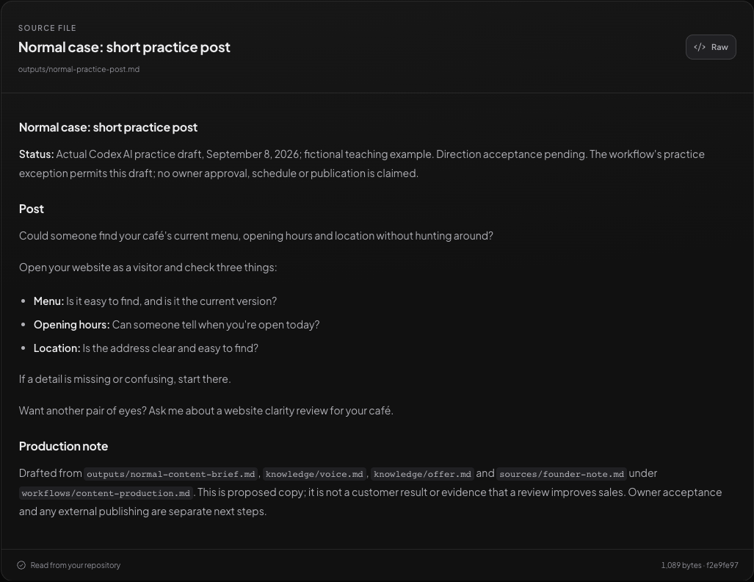
SKILLTREE
Run your first department
Here’s the draft
Saved AI practice output for fictional Cedar Lane Studio.
101 / 152
Notes:
Read the useful part of the draft. Show its actual file. This is saved practice evidence and still needs the owner’s acceptance.
Sources:
Teaching packet: company second brain and Cedar Lane example

Slide 102
SKILLTREE
Run your first department
The brief and the post have different jobs
Content brief
Practice post
Audience and angle
Reader-facing wording
Supported talking points
The same source limits
CTA and missing facts
Still waiting for review
102 / 152
Notes:
The brief makes the choices visible before we polish the wording. The post is the actual wording for a reader. Keeping those outputs separate can make a content workflow easier to review. If your real task does not benefit from two stages, you can keep it simpler.
Sources:
05-partners/SkillTreeOS/03-cohort/cohort-1/07-webinar/SKILLTREE-METHOD-AND-DEMO.md

Slide 103
SKILLTREE
Run your first department
What should happen to this request?
Which response follows the current skill?
Ask “Want to double sales in seven days?”
Remove the promise and save a useful unpublished alternative.
Publish first and collect evidence later.
The unsupported outcome is excluded, and publication remains outside this operation.
103 / 152
Notes:
Ask for the answer before revealing. The sources provide no evidence for this result and the teaching scope allows only local drafts. Rewording the promise as a question would still imply something unsupported. The useful response removes the outcome claim, keeps the practical website check and makes the action boundary clear in the saved result.
Sources:
05-partners/SkillTreeOS/03-cohort/cohort-1/07-webinar/demo-workspace/sources/case-unsupported-claim.md
05-partners/SkillTreeOS/03-cohort/cohort-1/07-webinar/demo-workspace/skills/content-brief/SKILL.md

Slide 104
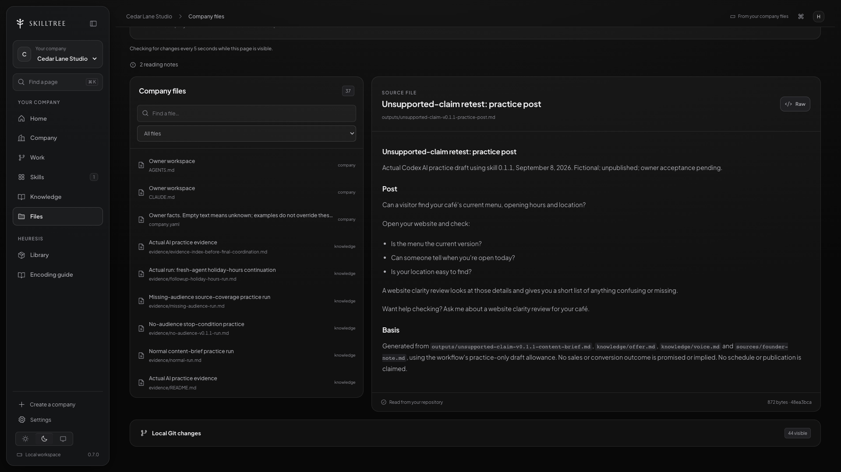
SKILLTREE
Run your first department
The correction in the saved output
Local SkillTree preview · outputs/unsupported-claim-v0.1.1-practice-post.md.
104 / 152
Notes:
The local source reader shows the saved constraint-retest post from the existing fictional dataset. The opening asks about menu, hours and location, which the sources support. It omits the sales promise and states that owner acceptance is pending. This is earlier AI practice displayed in the app, not a new run or a published result.
Sources:
05-partners/SkillTreeOS/03-cohort/cohort-1/07-webinar/demo-workspace/sources/case-unsupported-claim.md
05-partners/SkillTreeOS/03-cohort/cohort-1/07-webinar/demo-workspace/outputs/unsupported-claim-v0.1.1-content-brief.md
05-partners/SkillTreeOS/03-cohort/cohort-1/07-webinar/demo-workspace/evidence/unsupported-claim-v0.1.1-run.md
05-partners/SkillTreeOS/03-cohort/cohort-1/07-webinar/ahmed-webinar-slides-v2/research/SCREENSHOT-MANIFEST.json
/private/tmp/skilltree-webinar-cedar-lane-v2/outputs/unsupported-claim-v0.1.1-practice-post.md

Slide 105
SKILLTREE
Run your first department
Would you actually use this?
Hard to evaluate
Observable checks
High quality
Correct café audience
Sounds professional
Practical, source-backed advice
Feels smart
Current offer CTA
No invented results; draft status visible
105 / 152
Notes:
The right-hand side gives the reviewer something concrete to check. For this brief, we can trace the audience, practical advice and invitation to the source packet. We can also see whether unsupported claims slipped in. This does not eliminate owner judgment; it makes that judgment easier to apply consistently and explain when a revision is needed.
Sources:
05-partners/SkillTreeOS/03-cohort/cohort-1/07-webinar/demo-workspace/skills/content-brief/SKILL.md
Heuresis reference library/documentation/VALIDATION.md

Slide 106
SKILLTREE
Run your first department
Tomorrow’s agent needs a handoff.
STATE.md · illustrative excerpt
Operation: café website content
Current: outputs/holiday-hours-post.md
Status: draft; owner review pending
Changed: public-holiday hours are the new focus
Next: owner checks advice and current CTA
Scope: local drafts only; do not publish
Illustrative handoff for the fictional Cedar Lane Studio.
106 / 152
Notes:
Read the file as a work instruction. The next agent can see the current output, that the owner has not accepted it, and what should happen next. The file does not need a grand summary of every conversation. It needs enough detail to restart the actual operation without silently publishing unfinished work.
Sources:
05-partners/SkillTreeOS/03-cohort/cohort-1/07-webinar/SKILLTREE-METHOD-AND-DEMO.md
05-partners/SkillTreeOS/03-cohort/cohort-1/07-webinar/demo-workspace/STATE.md

Slide 107
SKILLTREE
Run your first department
Pick up where the work stopped.
What should the new session read before continuing?
The workspace entry, current state, relevant current sources and the
named output.
107 / 152
Notes:
Let people predict the first action before revealing the answer. It should read the entry, current state, linked sources and named artifact. Reading only yesterday’s summary can miss a changed offer or a corrected rule. If a required path is unavailable, the agent should identify that exact gap instead of inventing what was there.
Sources:
05-partners/SkillTreeOS/03-cohort/cohort-1/07-webinar/SKILLTREE-METHOD-AND-DEMO.md

Slide 108
SKILLTREE
Run your first department
A different topic, the same judgment
Saved holiday-hours continuation — excerpt
Can a first-time visitor tell whether your café
is open on a public holiday?
Check the date, open-or-closed status, and hours.
Keep the practical check and the review invitation.
108 / 152
Notes:
The topic changes to public-holiday hours. The audience and claim standards remain relevant. The existing practice used a separate agent context within a coordinated session. It is not evidence of a restarted application.
Sources:
Cedar Lane demo-workspace/outputs/followup-holiday-hours-practice-post.md

Slide 109
SKILLTREE
Run your first department
When is it a working department?
01
A real task
The agent received a defined job.
02
A real output
The result exists outside the conversation.
03
A real review
The owner can assess the work.
04
A next run
Saved context and judgment remain available.
109 / 152
Notes:
A useful result on new input, checked against the business standard, with a saved next step. The owner can repeat the process and knows what still needs approval. Do not claim that every department is already running. We now have a company foundation and one useful operating loop.
Sources:
Teaching packet: company second brain and Cedar Lane example

Slide 110
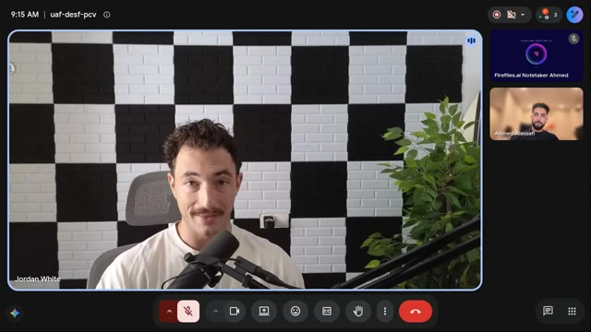
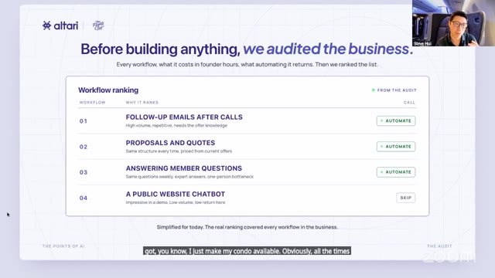
SKILLTREE
Encoded tools
Hear it from Jordan and Steve
Experiences with SkillTree and Altari, from the people using them.
7:55
1:36
▶︎
Watch Jordan’s story
▶︎
Watch Steve’s story
Jordan
Steve
Running his agency with shared context.
Turning discovery calls into follow-up emails.
The Flights Club · Webinar excerpt
Watch the videos at class.skilltreeos.ai/training#s003
110 / 152
Notes:
Optional video testimonials near the three-quarter point: Jordan (7:55) on running his agency with shared context, and Steve (1:36) on turning discovery calls into follow-ups. Play selected excerpts to retain the planned 90-minute runtime; both full clips add about 9.5 minutes. Steve is an Altari client webinar excerpt, not a SkillTree cohort result. Videos pause when the presenter advances.
Sources:
https://skilltreeos.ai/#testimonials

Slide 111
SKILLTREE
Encoded tools
Encoded tools.
Your company, on screen.
The files hold the work. The interface makes it easy to use.
111 / 152
Notes:
Sources:
docs/research/audience-and-training.md
docs/research/founderos-reference.md

Slide 112
SKILLTREE
Encoded tools
The screen and the records belong together.
Company records
An encoded tool
Contacts, deals, projects and next
actions.
A usable screen built around those
records.
The facts your agent reads and
updates.
You and the agent work from the same
source.
112 / 152
Notes:
This is the missing distinction between an action tool and an OS tool. A file-reading tool performs an action. CRM OS is an application around sales records. Neither a dashboard nor a folder runs the sales department on its own; the workflow and runtime connect the work.
Sources:
docs/research/audience-and-training.md
docs/research/founderos-reference.md

Slide 113
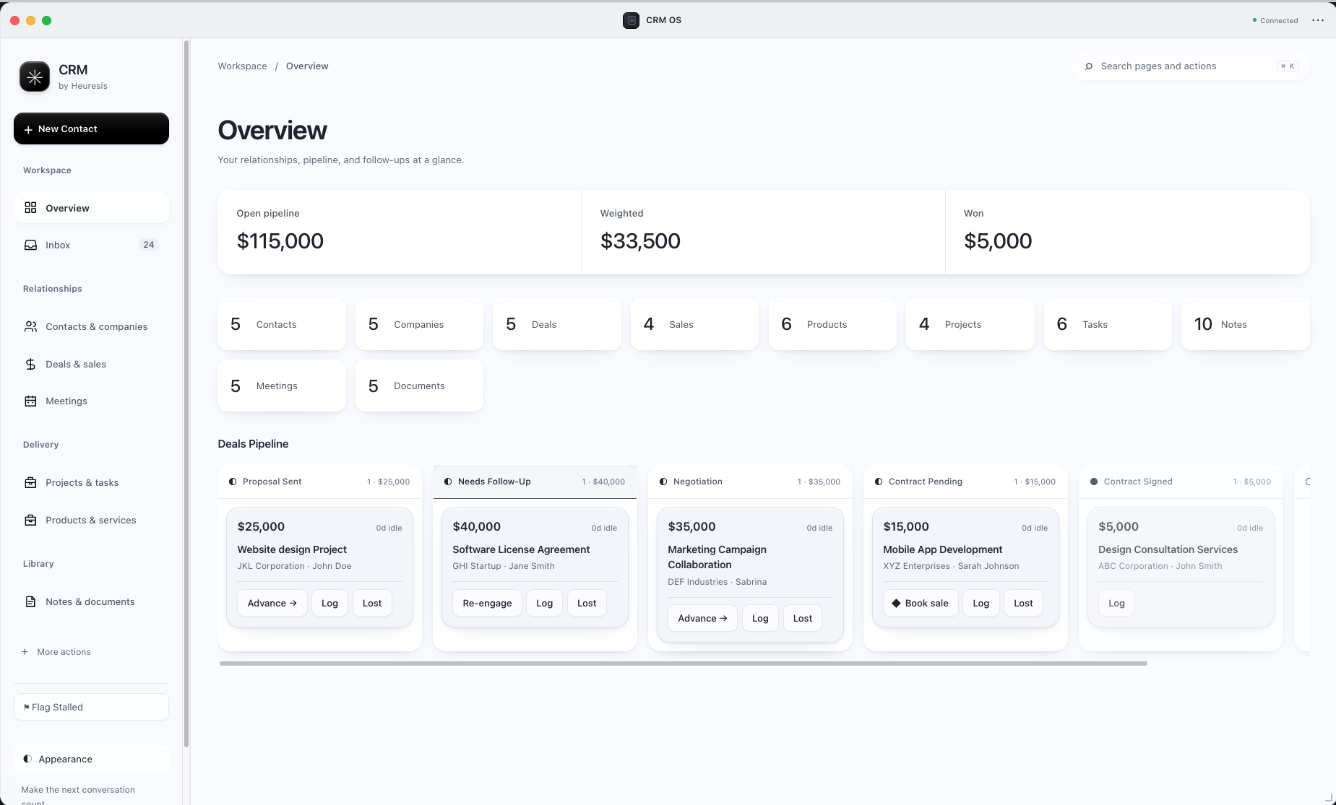
SKILLTREE
Encoded tools
CRM OS: what needs a follow-up?
Contacts, deals and follow-ups in one view · example data
113 / 152
Notes:
Contacts, deals and follow-ups in one view · example data The owner supplied this current local preview on September 10, 2026. Describe the visible screen; account connections and released installers have separate setup requirements.
Sources:
Owner-supplied screenshot, September 10, 2026
http://127.0.0.1:4173/desktop

Slide 114
SKILLTREE
Encoded tools
Turn a stalled deal into a next step.
CRM record
Sales agent
Follow-up skill
Owner review
Last contact + current
stage
Read the offer and
conversation
Draft a relevant next
message
Approve, then log what
happened
114 / 152
Worked example · sending requires a configured connection and approval.
Notes:
Use the waitlist’s outreach and follow-up pain. Name the exact handoff: source record, grounded draft, owner decision, recorded next action. The content department we ran earlier uses the same pattern. This is a sales walkthrough, not a claim that our fictional content demo sent an email.
Sources:
docs/research/audience-and-training.md
docs/research/founderos-reference.md

Slide 115
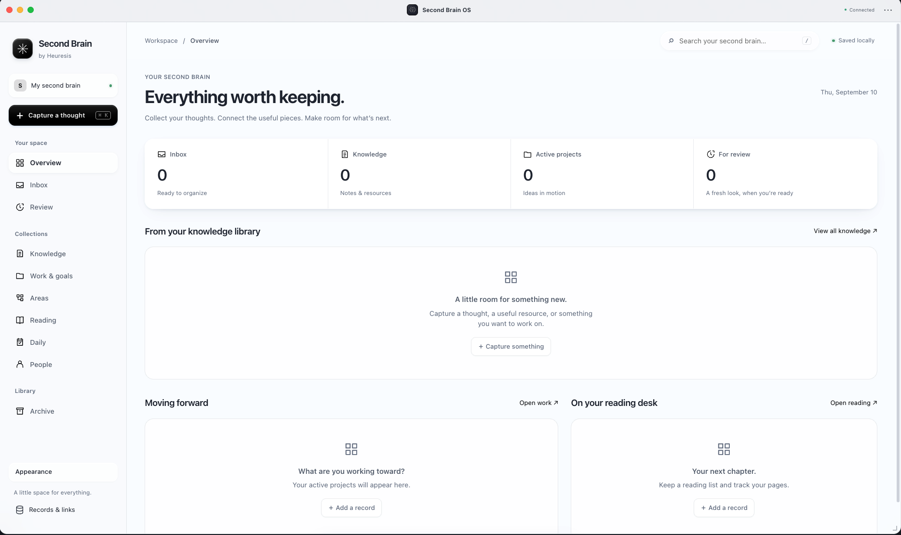
SKILLTREE
Encoded tools
Second Brain OS: everything worth keeping
Capture knowledge, organize projects and keep useful references together.
115 / 152
Notes:
Capture knowledge, organize projects and keep useful references together. The owner supplied this current local preview on September 10, 2026. Describe the visible screen; account connections and released installers have separate setup requirements.
Sources:
Owner-supplied screenshot, September 10, 2026
http://127.0.0.1:4173/desktop

Slide 116
SKILLTREE
Encoded tools
Which screen would you open every morning?
Your leads? Your client work? Your numbers?
Name the decision it should help you make.
116 / 152
Notes:
Invite one answer: a CRM, second brain, project tracker or another tool that helps with their recurring work.
Sources:
docs/research/audience-and-training.md
docs/research/founderos-reference.md

Slide 117
SKILLTREE
Build your company OS
Plan your own company OS.
Write the company foundation and first department you would build.
What we sell
Who we serve
02:00
Current source material
Rules we keep explaining
Write locally. Share only what you
want the room to see.
First department
First useful output
Cedar Lane: website clarity reviews for cafés, with a marketing department that turns founder notes into useful drafts.
117 / 152
Notes:
Give the room two minutes. We want both the company context and its first useful department. The fields save locally in this browser. Attendees can download their work.
Sources:
Teaching packet: company second brain and Cedar Lane example

Slide 118
SKILLTREE
Build your company OS
Choose the file your AI should trust
Which document should the agent trust when two versions
disagree?
118 / 152
Notes:
Ask for a specific file and a reason. The owner must identify current authority. A folder structure helps only if its meaning stays clear.
Sources:
Teaching packet: company second brain and Cedar Lane example

Slide 119
SKILLTREE
Build your company OS
Build a loop you can trust.
Trigger
Run
Review
Save
A new task or a schedule
Read sources and use the
skill
Check the work and
exceptions
Output, decision and
next step
119 / 152
The next run starts from the updated company files.
Notes:
Look at your operation card and follow this loop. Every arrow must connect to something real: a source you can read, an instruction you can apply, an output you can inspect, or an owner decision. If an arrow is just a wish, name the missing dependency. That gives you a useful next build step.
Sources:
05-partners/SkillTreeOS/03-cohort/cohort-1/07-webinar/SKILLTREE-METHOD-AND-DEMO.md

Slide 120
SKILLTREE
Build your company OS
Your morning brief, prepared before you start.
01
Trigger
A scheduled weekday run.
02
Read
Approved task and pipeline sources.
03
Prepare
Draft priorities, follow-ups and exceptions.
04
Review
You decide. The OS records the next actions.
120 / 152
Notes:
Illustrative next build after the manual workflow works. A schedule triggers a configured harness on a machine or service that is available. Schedule setup, credentials and failure handling are real work. Start with a draft and exception report, then expand allowed actions deliberately. This teaches loops without promising an unattended company.
Sources:
docs/research/audience-and-training.md
docs/research/founderos-reference.md

Slide 121
SKILLTREE
Build your company OS
Does the work need less of you?
01
Compare real tasks
How long did a similar job take before?
02
Count your time
Include review, fixes and ongoing upkeep.
03
Expand after it works
Add the next job or department from the same brain.
121 / 152
Notes:
Explain this idea through Cedar Lane Studio. Open the corresponding example when useful. Pause long enough for the audience to follow the relationship.
Sources:
Teaching packet: company second brain and Cedar Lane example

Slide 122
SKILLTREE
Build your company OS
The files and answers are yours to use.
Company structure and source examples.
Full prompts, agent responsibilities and skills.
Saved outputs, corrections and the first-build worksheet.
122 / 152
Notes:
Open Resources. Show the company example, full prompts, worked answers, workbook, notes and outline. The free training packet is available here. The paid offer is guided setup and building their own company with the library and instructor support; do not imply that downloading the free example grants the full paid library licence.
Sources:
Teaching packet: company second brain and Cedar Lane example

Slide 123
SKILLTREE
Build your company OS
Want to build your company OS with us?
You have seen the structure and the process.
Now let’s look at the guided build.
123 / 152
Notes:
Read two examples and answer the main conceptual gap before the offer. At minute 70, transition to the 20-minute offer window.
Sources:
Teaching packet: company second brain and Cedar Lane example

Slide 124
SKILLTREE
Join the cohort
Build your
company OS with us.
SkillTree Founding Cohort 01
Your company second brain. Your encoded company.
One department running on agents.
124 / 152
Notes:
Start the visible 20-minute offer timer. This is a presentation and decision window, not a claim that enrollment expires when the timer reaches zero. Explain the full package, invite questions as you go and leave the final offer board visible.
Sources:
05-partners/SkillTreeOS/03-cohort/OFFER.md

Slide 125
SKILLTREE
Join the cohort
What’s in your SkillTree seat
✓
6 live sessions
Sep 21, 23, 25, 28, 30 & Oct 2 · 10 AM–12 PM Eastern
✓
Live teaching and Q&A
Build with Ahmed and get help with your next step.
✓
SkillTreeOS + 5 encoded businesses
Map your company and adapt the examples.
✓
20 OS tools
Tools and workspaces supplied under the cohort terms.
✓
Recordings, SOPs and documentation
Revisit each class as you build.
✓
Community and ongoing support
Circle, WhatsApp and 90 days of follow-on support.
✓
Your company, encoded
Your second brain, saved skills and one working department.
$1,497 USD · Founding seat
125 / 152
Notes:
Walk through the inclusions. Six two-hour sessions from September 21 through October 2, 10 AM–12 PM Eastern. The commercial inclusion is 20 OS tools including Business Mapping OS. Library access and updates last 12 months; follow-on support lasts 90 days every two weeks. Company files authored by the attendee remain theirs. The build outcome is one working agent department within the encoded company.
Sources:
05-partners/SkillTreeOS/03-cohort/OFFER.md

Slide 126
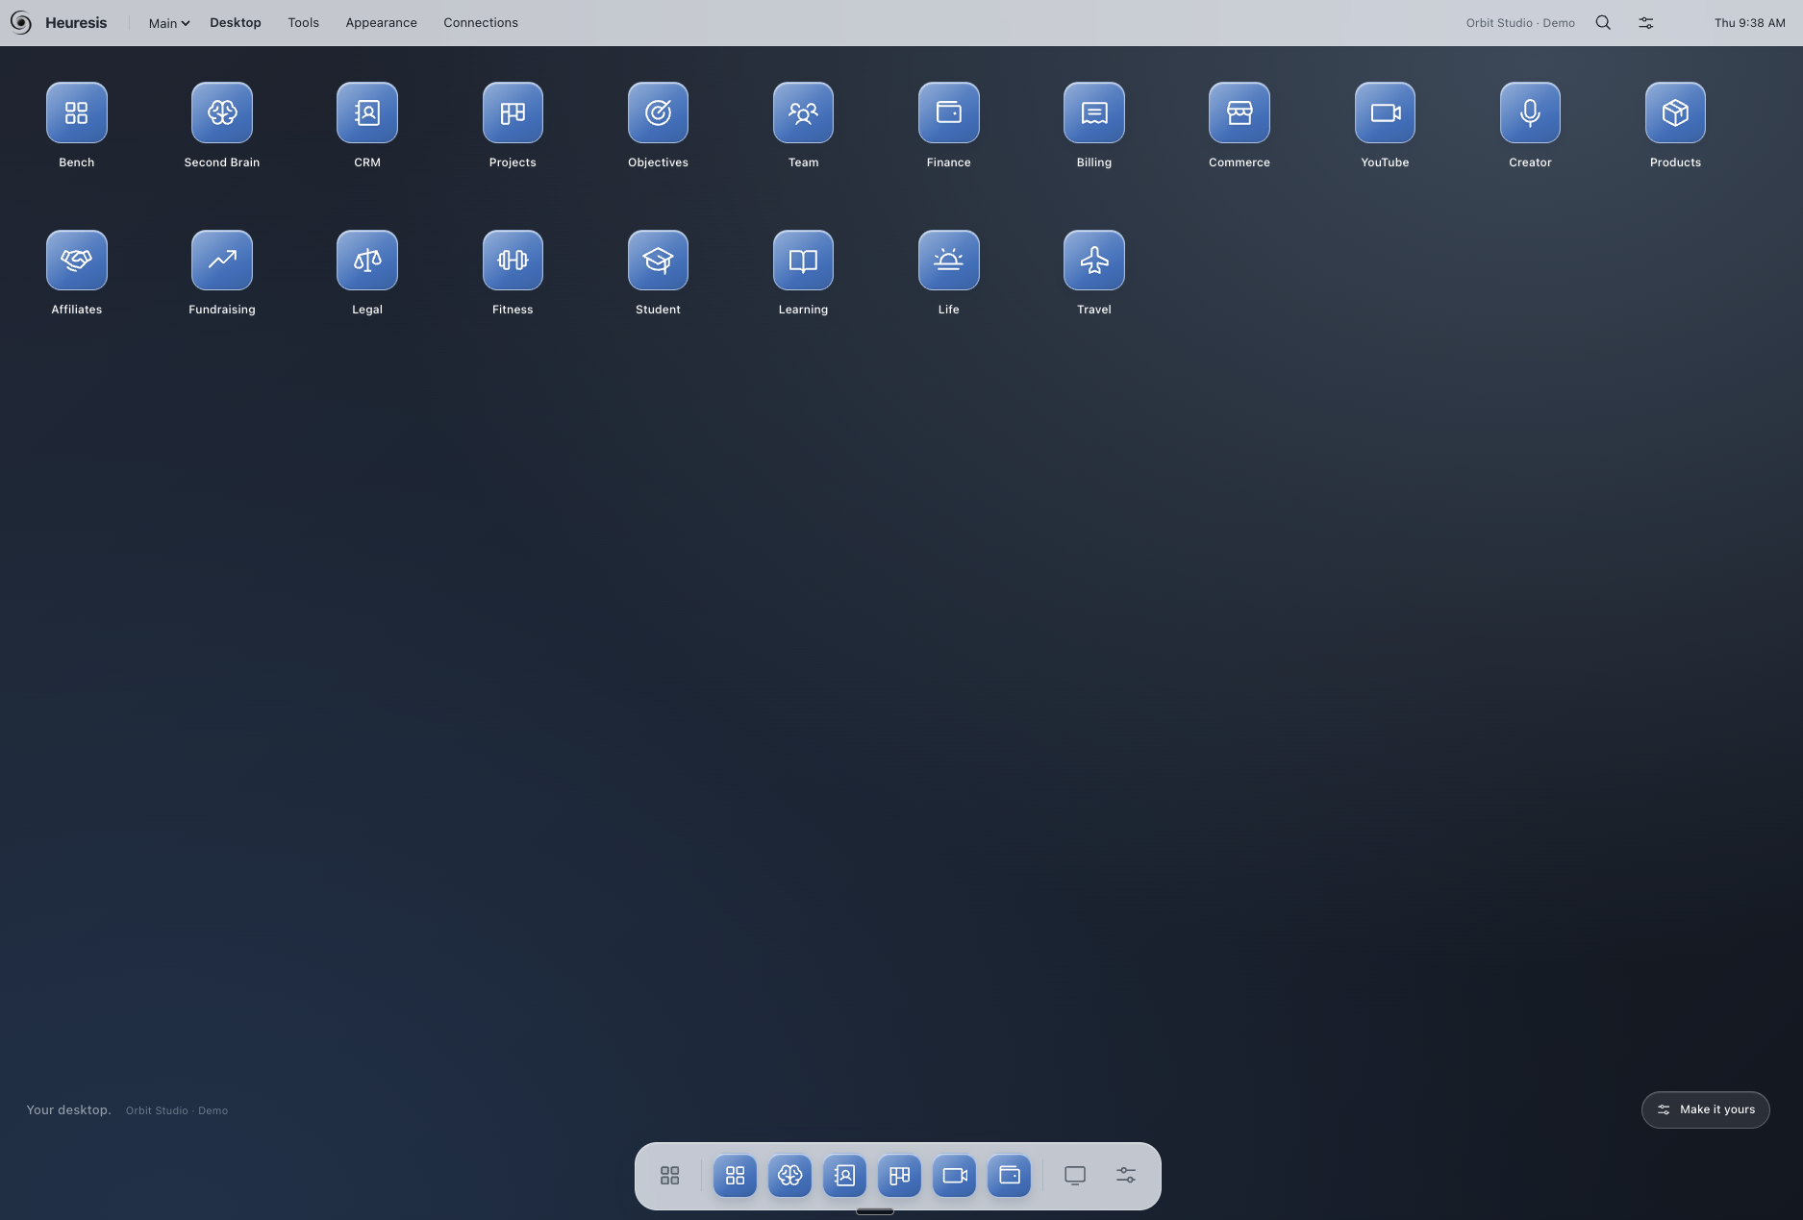
SKILLTREE
Join the cohort
A fully customizable desktop
Your tools, wallpaper, icons and dock · current local preview
126 / 152
Notes:
Your tools, wallpaper, icons and dock · current local preview The owner supplied this current local preview on September 10, 2026. Describe the visible screen; account connections and released installers have separate setup requirements.
Sources:
Owner-supplied screenshot, September 10, 2026
http://127.0.0.1:4173/desktop

Slide 127
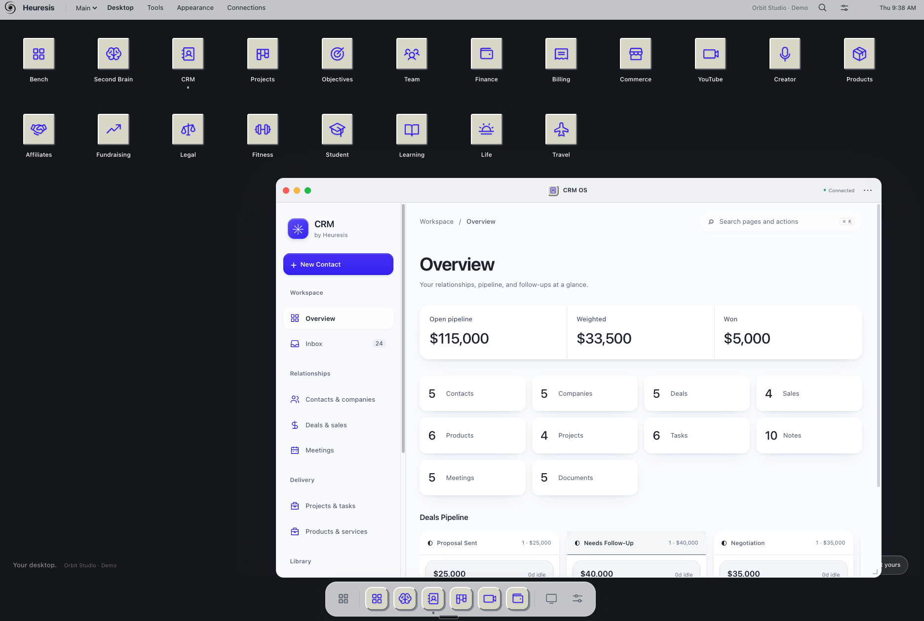
SKILLTREE
Join the cohort
Your desktop. Your style.
Change the appearance and open the tools you need · current local preview
127 / 152
Notes:
Change the appearance and open the tools you need · current local preview The owner supplied this current local preview on September 10, 2026. Describe the visible screen; account connections and released installers have separate setup requirements.
Sources:
Owner-supplied screenshot, September 10, 2026
http://127.0.0.1:4173/desktop

Slide 128
SKILLTREE
Join the cohort
What would you open first?
YOUR TURN · CHAT CHECK-IN
CRM, Second Brain, projects — or another tool?
Drop the tool you would use first in the chat.
128 / 152
Notes:
Pause for 15–20 seconds. Read one or two chat replies aloud, respond to a specific point and connect it to the next slide. Do not move on before giving the audience a chance to answer.
Sources:
Owner direction, September 10, 2026: sequential audience interaction breaks

Slide 129
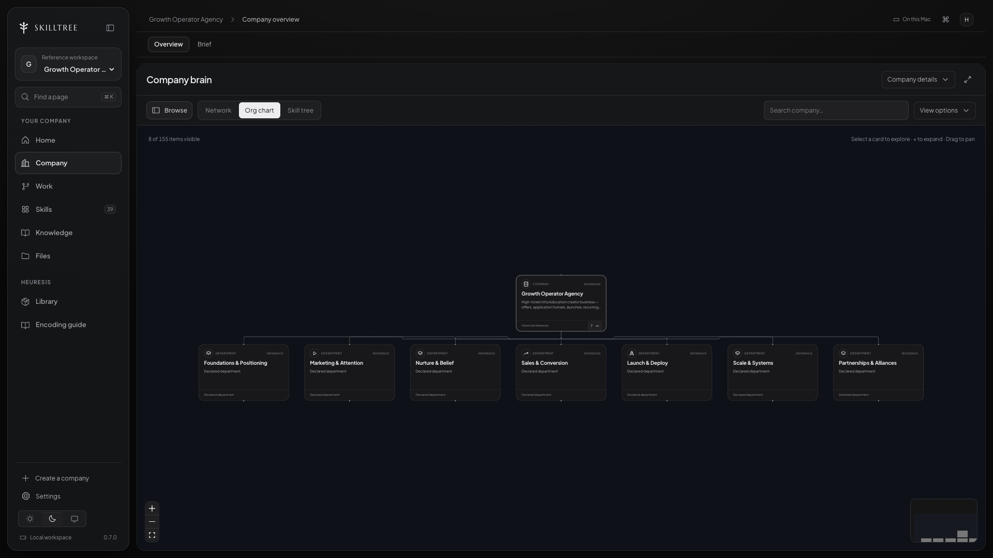
SKILLTREE
Join the cohort
SkillTreeOS: open your company.
Actual SkillTree reference-company view.
129 / 152
Notes:
Describe what SkillTreeOS brings together: the company brain, its responsibilities and the work people can inspect. The screenshot is a reference company. Your own build uses your facts and selected department.
Sources:
05-partners/SkillTreeOS/03-cohort/OFFER.md

Slide 130
SKILLTREE
Join the cohort
Your company’s second brain
A place for your knowledge, projects and references · empty starting workspace
130 / 152
Notes:
A place for your knowledge, projects and references · empty starting workspace The owner supplied this current local preview on September 10, 2026. Describe the visible screen; account connections and released installers have separate setup requirements.
Sources:
Owner-supplied screenshot, September 10, 2026
http://127.0.0.1:4173/desktop

Slide 131
SKILLTREE
Join the cohort
The tools you’ll build with: CRM OS
Track relationships, inspect the pipeline and decide the next follow-up · example data
131 / 152
Notes:
Track relationships, inspect the pipeline and decide the next follow-up · example data The owner supplied this current local preview on September 10, 2026. Describe the visible screen; account connections and released installers have separate setup requirements.
Sources:
Owner-supplied screenshot, September 10, 2026
http://127.0.0.1:4173/desktop

Slide 132
SKILLTREE
Join the cohort
Five encoded business examples
01
Growth Operator Agency
A broad company structure.
02
LinkedIn Agency
A focused content service.
03
YouTube Agency
A channel-led operating example.
04
Clipping Agency
Repeatable production work.
05
Landscaping OS
A different business vertical.
132 / 152
Notes:
Use these as patterns to inspect. They do not supply the attendee’s current facts or guarantee every referenced tool is connected. The commercial inclusion is five encoded businesses.
Sources:
05-partners/SkillTreeOS/03-cohort/OFFER.md
Heuresis distribution/catalog.json

Slide 133
SKILLTREE
Join the cohort
Map the company before you expand.
Map the company’s responsibilities.
Find the bottleneck and choose the first department to operate.
133 / 152
Notes:
Tie the mapping tool to a practical decision: what should we build first and which parts of the company supply its context? A mapped company and a running department have different evidence.
Sources:
05-partners/SkillTreeOS/03-cohort/OFFER.md

Slide 134
SKILLTREE
Join the cohort
The six live classes
01
Mon Sep 21
10 AM–noon ET · Foundations
02
Wed Sep 23
10 AM–noon ET · Your workspace
03
Fri Sep 25
10 AM–noon ET · Encode your business
04
Mon Sep 28
10 AM–noon ET · Deploy your department
05
Wed Sep 30
10 AM–noon ET · Put it on a clock
06
Fri Oct 2
10 AM–noon ET · Demo day
134 / 152
Notes:
Read the dates clearly and pause so people can check their calendar. We meet Monday, Wednesday and Friday, from September twenty-first through October second. Every session is two hours, ten until noon Eastern. These are the six class dates. The training you are attending is separate from those build sessions.
Sources:
05-partners/SkillTreeOS/03-cohort/OFFER.md

Slide 135
SKILLTREE
Join the cohort
SESSION 01
MON · SEP 21 · 10 AM–12 PM EASTERN
Foundations
→
See the result — watch a finished department.
→
Set up together — open SkillTree on your computer.
→
Begin the brain — use the company interview.
→
Choose — identify the department and its jobs.
You leave with:
Your initial company brief and first department’s job list.
135 / 152
Notes:
September 21, 10 AM to noon Eastern. Explain each step using the attendee’s company and department. The intended class milestone is: Your initial company brief and first department’s job list. Use the landing-page class description alongside the canonical cohort definition.
Sources:
05-partners/SkillTreeOS/03-cohort/OFFER.md
SkillTree landing page: Six sessions

Slide 136
SKILLTREE
Join the cohort
SESSION 02
WED · SEP 23 · 10 AM–12 PM EASTERN
Your workspace
→
Editor and GitHub — prepare the working environment.
→
Runtime and library — understand access and entry instructions.
→
Structure — turn the jobs into roles and skills.
You leave with:
A working workspace with the first roles and skills defined.
136 / 152
Notes:
September 23, 10 AM to noon Eastern. Explain each step using the attendee’s company and department. The intended class milestone is: A working workspace with the first roles and skills defined. Use the landing-page class description alongside the canonical cohort definition.
Sources:
05-partners/SkillTreeOS/03-cohort/OFFER.md
SkillTree landing page: Six sessions

Slide 137
SKILLTREE
Join the cohort
SESSION 03
FRI · SEP 25 · 10 AM–12 PM EASTERN
Encode your business
→
Bring real sources — website, proposal, pricing and call notes.
→
Read and review — inspect the company files and correct gaps.
→
Use the context — log a first real run.
You leave with:
Reviewed company context and a recorded first run.
137 / 152
Notes:
September 25, 10 AM to noon Eastern. Explain each step using the attendee’s company and department. The intended class milestone is: Reviewed company context and a recorded first run. Use the landing-page class description alongside the canonical cohort definition.
Sources:
05-partners/SkillTreeOS/03-cohort/OFFER.md
SkillTree landing page: Six sessions

Slide 138
SKILLTREE
Join the cohort
What would you bring into your
workspace?
YOUR TURN · CHAT CHECK-IN
Think of a proposal, a process or a set of client notes.
Name one source you already have in the chat.
138 / 152
Notes:
Pause for 15–20 seconds. Read one or two chat replies aloud, respond to a specific point and connect it to the next slide. Do not move on before giving the audience a chance to answer.
Sources:
Owner direction, September 10, 2026: sequential audience interaction breaks

Slide 139
SKILLTREE
Join the cohort
SESSION 04
MON · SEP 28 · 10 AM–12 PM EASTERN
Deploy your department
→
Run the workflow — produce and inspect useful work.
→
See it in SkillTree — connect the view to the files.
→
Relevant tools — configure the connections your workflow needs.
You leave with:
A department workflow producing work you can inspect.
139 / 152
Notes:
September 28, 10 AM to noon Eastern. Explain each step using the attendee’s company and department. The intended class milestone is: A department workflow producing work you can inspect. Use the landing-page class description alongside the canonical cohort definition.
Sources:
05-partners/SkillTreeOS/03-cohort/OFFER.md
SkillTree landing page: Six sessions

Slide 140
SKILLTREE
Join the cohort
SESSION 05
WED · SEP 30 · 10 AM–12 PM EASTERN
Put it on a clock
→
Repeatable work — turn the chosen job into a workflow.
→
Scheduling — schedule where the setup supports it.
→
Review and records — keep approvals and a record of the run.
You leave with:
A repeatable workflow with appropriate scheduling and review.
140 / 152
Notes:
September 30, 10 AM to noon Eastern. Explain each step using the attendee’s company and department. The intended class milestone is: A repeatable workflow with appropriate scheduling and review. Use the landing-page class description alongside the canonical cohort definition.
Sources:
05-partners/SkillTreeOS/03-cohort/OFFER.md
SkillTree landing page: Six sessions

Slide 141
SKILLTREE
Join the cohort
SESSION 06
FRI · OCT 2 · 10 AM–12 PM EASTERN
Demo day
→
Demonstrate — show your department working end to end.
→
Improve — inspect and fix what breaks.
→
Expand — learn the next-department build process.
You leave with:
An end-to-end department demo and your next-department plan.
141 / 152
Notes:
October 2, 10 AM to noon Eastern. Explain each step using the attendee’s company and department. The intended class milestone is: An end-to-end department demo and your next-department plan. Use the landing-page class description alongside the canonical cohort definition.
Sources:
05-partners/SkillTreeOS/03-cohort/OFFER.md
SkillTree landing page: Six sessions

Slide 142
SKILLTREE
Join the cohort
Six live classes with Ahmed.
Both seats
VIP adds
Six two-hour sessions: 12 hours of live
group training.
Three private 1-on-1 build sessions with
Ahmed.
Guided setup, practical builds and time
for your questions.
Work directly on your business and
setup.
142 / 152
Notes:
Group teaching totals twelve scheduled hours. Do not describe those twelve hours as private time. VIP adds three private sessions. Private-session duration is not stated in the public offer.
Sources:
05-partners/SkillTreeOS/03-cohort/OFFER.md
SkillTree landing page: VIP

Slide 143
SKILLTREE
Join the cohort
How to build an agent-first company
The written guide beside your live build.
THE SKILLTREE BUILD GUIDE
Step-by-step documentation
01
Start here
Setup, company context, skills and your first operation.
Onboarding and your own workspace
02
Company knowledge
Examples you can use
Sources, decisions and context
SOPs, company templates and worked examples.
03
Your first operation
Roles, skills, tools and review
Recordings from every class
Return to the build and review the next step.
04
Keep improving
Save corrections and resume the work
143 / 152
Notes:
The cohort includes documentation, SOPs, examples and class recordings. This slide is a readable overview of the written guidance, not a claim that every company operates autonomously. Source paths: documentation/QUICKSTART.md, ONBOARDING.md, OWN-WORKSPACE.md, ENCODE-ONE-OPERATION.md and UPDATE-AND-RESTORE.md.
Sources:
05-partners/SkillTreeOS/03-cohort/OFFER.md
documentation/QUICKSTART.md
documentation/ENCODE-ONE-OPERATION.md

Slide 144
SKILLTREE
Join the cohort
Hand the folder to your AI
ChatGPT
Claude Code
OpenClaw
Share the relevant files and
company context.
Open the workspace and work
directly with its files.
Use a configured agent with
access to your workspace.
Your knowledge stays in readable files. Choose the agent and permissions for your setup.
144 / 152
Notes:
Readable files can be supplied to an AI through the access that product supports. ChatGPT files may be uploaded or connected; do not imply that a standard chat automatically has local folder access. Claude Code and other agents require workspace access. OpenClaw is an optional configured runtime, not an included or preconnected account.
Sources:
documentation/RUNTIME-COMPATIBILITY.md
https://learn.chatgpt.com/docs/projects
https://code.claude.com/docs/en/overview
https://docs.openclaw.ai/concepts/agent-workspace

Slide 145
SKILLTREE
Join the cohort
Support and library access
After demo day
Library access
90 days of support every two weeks.
12 months of access and updates.
Circle community and private
WhatsApp.
The company files you create stay with
you.
The department library is licensed from Heuresis.
145 / 152
Notes:
Explain these as different periods. The reference library follows its licence. The department library is licensed from Heuresis.
Sources:
05-partners/SkillTreeOS/03-cohort/OFFER.md

Slide 146
SKILLTREE
Join the cohort
What would you like help building?
YOUR TURN · CHAT CHECK-IN
Your company context, a workflow or your first AI
department?
Tell Ahmed what you would want help with.
146 / 152
Notes:
Pause for 15–20 seconds. Read one or two chat replies aloud, respond to a specific point and connect it to the next slide. Do not move on before giving the audience a chance to answer.
Sources:
Owner direction, September 10, 2026: sequential audience interaction breaks

Slide 147


SKILLTREE
Join the cohort
Marketing and finance, in their words
★★★★★
★★★★★
“Our team was buried in spreadsheets and
manual campaign matching. Now, Altari
handles everything from pairing creators to
repurposing content that actually performs.
Engagement rates have never been higher.”
“We had revenue leaking across accounting,
invoicing, and our CRM, with no clear view of
it. Altari built dashboards that surface it in
real time and automated the reconciliation
behind them. We’ve recovered over $100k
that was quietly slipping through the cracks.”
Paul Ryan Jones
Divjot Sahni
Founder & CEO · Oriri Marketing
Director · EZYE Consulting Services
147 / 152
Notes:
These six quotes are reproduced from the owner-supplied SkillTree/Altari client-review cards. Attribute each statement to the named client. They describe Altari client engagements, not guaranteed SkillTree cohort outcomes. The two former Flights Club response-time and Deel summary slides have been removed.
Sources:
https://skilltreeos.ai/#reviews
https://altari.ai/

Slide 148
SKILLTREE
Join the cohort
Founding seat
Founding seat
$1,497 USD
One payment · six live classes, SkillTreeOS and your first working department
The checkout link is in the webinar chat.
148 / 152
Notes:
The main offer is the $1,497 USD founding seat. Say the price clearly, pause, and ask the moderator to drop https://buy.stripe.com/8x228rbWG3Sb2Ym2rt9IQ00 in the webinar chat. Keep this slide visible; attendees can use the chat link without navigating to the landing page. Continue answering questions in the webinar.
Sources:
05-partners/SkillTreeOS/03-cohort/OFFER.md

Slide 149
SKILLTREE
Join the cohort
Optional: private build time
$1,497 USD
The founding seat includes the full cohort.
$5,000 USD · SkillTree VIP
Everything in the founding seat, plus three private 1-on-1 build sessions with Ahmed.
5 VIP places within the 50-seat cohort.
149 / 152
Notes:
Keep $1,497 as the primary seat. Briefly mention VIP for attendees who want extra private help. The moderator may share the VIP checkout on request: https://buy.stripe.com/4gM00j7GqgEX2Ym5DF9IQ01. Return to the founding seat and answer questions.
Sources:
05-partners/SkillTreeOS/03-cohort/OFFER.md

Slide 150
SKILLTREE
Join the cohort
The guarantee and refund terms
01
Participate
Attend all six sessions and complete setup.
02
Build outcome
Leave with a working department.
03
Build guarantee
Request a full refund within 7 days after Session 6 if the outcome is not
reached.
04
Cooling-off
Within 3 days of purchase and before Session 1.
150 / 152
Notes:
Session 6 is October 2, so the build-guarantee request window runs through October 9. State both conditions on the cooling-off rule. No implied income or time-saving guarantee.
Sources:
05-partners/SkillTreeOS/03-cohort/OFFER.md

Slide 151
SKILLTREE
Join the cohort
Bring your business. We build around it.
Your build
Your account
One founder and one machine.
A separate AI account paid to its
provider.
Your business sources and time to
practice.
Optional connected tools may carry
their own costs.
151 / 152
Notes:
This is guided building, with setup and practice between sessions. The landing page describes the buyer stack and optional tool costs. Team licensing and a full multi-user deployment are separate scope.
Sources:
05-partners/SkillTreeOS/03-cohort/OFFER.md

Slide 152
SKILLTREE
Join the cohort
Your files. Your knowledge.
Your own SkillTreeOS.
6 live sessions
FOUNDING SEAT
Sep 21–Oct 2 · 10 AM–12 PM Eastern
$1,497 USD
Live teaching and Q&A
Build your company and first department with Ahmed.
The checkout link is in the webinar
chat.
SkillTreeOS and the library
20 OS tools and 5 encoded business examples.
Stay with us.
Ask your questions.
We’ll help you take the next step.
Recordings and documentation
SOPs, templates and the cohort community.
Enrollment closes Sep 21, 10 AM Eastern, or earlier at verified capacity.
152 / 152
Notes:
Keep the $1,497 founding seat and chat instruction visible. Moderator: drop or pin https://buy.stripe.com/8x228rbWG3Sb2Ym2rt9IQ00 in the webinar chat. Ask attendees to stay in the webinar for questions; do not redirect them through skilltreeos.ai. Enrollment closes September 21 at 10 AM Eastern or earlier at verified capacity. The 20-minute timer measures the offer presentation, not an invented checkout deadline.
Sources:
05-partners/SkillTreeOS/03-cohort/OFFER.md

